Slide 1
TITLE OF PRESENTATION Subtitle of Presentation
Lessons for Life’s End:
How to Cope with Life-Threatening Illness
Holly G. Prigerson, Ph.D.
Irving Sherwood Wright Professor of Geriatrics
Professor of Sociology in Medicine
Director, Center for Research on End-of-Life Care
Notes:
Depends on how quickly you go through them, but I would say around 10 slides, possibly a little more. The dean will have introduced you, but maybe you could also say a few words about what brought you to Weill Cornell and/or what drew you to this field.

Slide 2
This Is A Tough Topic…BUT
NOT talking about these things exacerbates the problem
Talking is a necessary first step

Slide 3
Coping with Cancer Study
Design: A National Institute of Health (NIH)-funded, prospective study of patients with advanced cancer
Setting: 8 outpatient cancer clinics in the United States (e.g., Yale, Memorial Sloan-Kettering, University of Texas Southwestern, Dana-Farber)
Participants: Adult patients with metastatic cancers who failed at least 1 round of chemotherapy, whom physicians identified as terminally ill at study enrollment, and who subsequently died
Assessments: Patients and caregivers assessed 4 months before patient’s death; a month after the patient died, caregivers asked about patient’s death and medical chart was reviewed

Slide 4
4 Myths About End-of-Life Care…Busted!
Myth #1: Life-prolonging care: more care is better care; you get what you pay for
Myth #2: Talking about death is harmful: doctors who discuss prognosis with patients make them hopeless
Myth #3: Psychosocial needs: religious copers die peacefully; therapeutic bonds don’t matter with “real” doctors
Myth #4: A “good death” is an oxymoron: not possible

Slide 5
Myth #1: Myths about Life-Prolonging Care
Conventional Wisdom:
More care is better care
You get what you pay for

Slide 6
How Can More Be Less?
Human nature to want more of a good thing
If medical care is good, more must be better
But, aggressive end-of-life care includes:
intubation (breathing tube)
resuscitation (chest compression, shock)
feeding tubes
“palliative” chemotherapy

Slide 7
Patients & Families Often Don’t Know What Life-Prolonging Care Actually Entails
Example: INTUBATION
Many are not aware that when people are intubated (i.e., have a tube connected to a machine to breathe) they:
can’t talk
can’t eat with their mouth
are usually sedated (unconscious)

Slide 8
Example: PALLIATIVE CHEMOTHERAPY
Patients think: “chemo will cure me”; “palliative” means I should feel better
BUT, palliative chemo results in
worse quality of life – no actual palliation
no survival benefit
higher odds of dying in intensive care unit (ICU)
lower odds of dying at home
lower odds of dying where family thought you wanted to die

Slide 9
Data Show End-of-Life Care Is Overly Aggressive & Becoming More So
In 2008, >50% of incurable cancer patients were getting palliative chemo 4 months from death; in 2014, 81%
Across United States
Intensive Care Unit (ICU) stays in last month of life are common (~30%) ; the trend is increasing
Hospice referrals within days of death are common (45%) – too late to offer much help
Bankrupting of our health care system
25% of Medicare costs spent on last year of life
40% of that is for care in last month of life
Notes:
32% die in hospice
74% patients prefer comfort to life-prolonging care

Slide 10
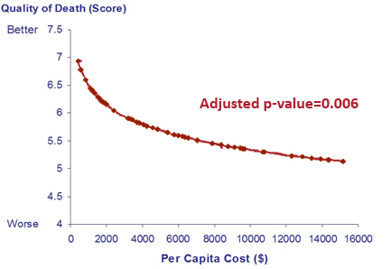
Can’t Buy a Better Death: The High Cost of Interventions
Increased cost of late-term interventions
directly related to
Lower quality of death

Slide 11
Myth #2: Conflicting Beliefs Re: Talking About Death with Doctors
Conventional Wisdom:
Patients base their prognostic understanding on what their doctors tell them
BUT, doctors shouldn’t discuss death with patients because this will make them needlessly hopeless

Slide 12
So Where Do Patients Get Their
Information About Their Prognosis?

Slide 13
Many Patients Don’t Think They’re Dying & Don’t Understand Treatments
63% patients 4 months before death are unaware they’re dying
80% of incurable patients receiving chemotherapy believe that chemotherapy is being administered to cure them
72% patients say they would want their doctor to discuss their prognosis with them if they knew it
But only 17% report being told

Slide 14
Why Don’t Doctors Have End-of-Life Discussions?
not taught how
fear it may make patients hopeless
believe it doesn’t change outcomes

Slide 15
Our Data Suggest Otherwise!
End-of-life discussions do not make patients more hopeless; on the contrary, they’re associated with:
Greater acceptance of terminal illness
More realistic life-expectancy estimates
Preferences for comfort care over life-extension at any cost
More frequent completion of do-not-resuscitate orders
Less non-curative, burdensome aggressive care
Lower costs to the healthcare system

Slide 16
Myth #3: Attending To Psychosocial Needs
Conventional Wisdom:
Religious patients die more peacefully
Therapeutic bonds only matter with therapists not with “real” doctors

Slide 17
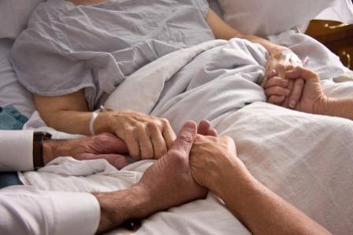
Religious Coping
Religious copers – people who seek God’s love & support to cope with illness
Religious copers – 3 times more likely to be on ventilator or resuscitated in their last week of life vs. non-religious copers
(11% vs. 4%)
Notes:
“seeking God’s love and care”)
. Individuals who use positive religious coping are likely to seek spiritual support and look for meaning in a traumatic situation. Negative religious coping (or Spiritual Struggles) expresses conflict, question, and doubt regarding issues of God and faith.

Slide 18
Spiritual Support From Medical Community
To what extent are your religious/spiritual needs being supported by the medical system
(e.g., doctors, nurses, hospital chaplain)?”
Responses:
Not at all
To a small extent
To a moderate extent
To a large extent
Completely supported
Low Support
High Support

Slide 19
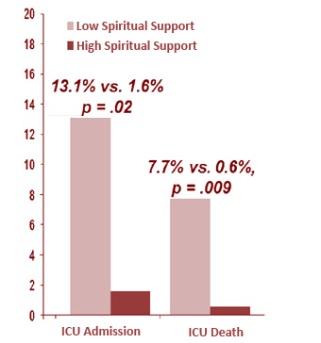
ICU Admissions/Deaths In The Last Week Of Life By Spiritual Care From The Health Care Team
Adjusted Rates of ICU stay
in last week
Total Sample
(n = 303)
Racial/ethnic
Minorities
(n = 118)
High Religious Coping Patients (n = 159)

Slide 20
Therapeutic Alliance –
Based on Mutual Trust, Empathy and Shared Goals of Care
Of all the possible alliances a patient can develop, such as an alliance with:
Other oncology clinic staff
Oncology social workers
Mental health professionals
Clergy members
Palliative care physicians
A patient’s relationship with his/her oncologist is the most important relationship in terms of coping with his/her fate
Patients are four times less likely to consider suicide if they report a strong bond with their oncologist

Slide 21
Myth #4: A Good Death is An Oxymoron
Conventional Wisdom:
Nothing can be done to improve how we die

Slide 22
What Can Patients, Family Members,
& Clinicians Do for Patients To Die Better?
Lessons from the
“Coping With Cancer” Study

Slide 23
How to Improve End-Of-Life Care
Patients/families should ask doctors about prognosis, curability
2. Clinicians should be encouraged to:
discuss prognosis, curability
explain risks of aggressive care; benefits of palliative care
discuss end-of-life goals of care
complete advance directive (e.g., Do Not Resuscitate order)

Slide 24
How to Improve End-Of-Life Care (cont’d)
Patients/family may need help accepting prognosis & understanding treatment options
Clinicians should confirm comprehension so patients can work with them to make informed choices & live remaining days consistent with patient goals & values

Slide 25
"Take-Home” Messages
At end-of-life, more aggressive, expensive care is often worse care
Patients, families & doctors need to have honest discussions about prognosis & treatment options
Religious beliefs and therapeutic bonds powerfully
influence care and need to be addressed
4. A “good death” is achievable with informed decision- making & attention to psychosocial issues

Slide 26
This Is A Tough Topic…BUT
NOT talking about these things exacerbates the problem
Talking is a necessary first step
Thank you for listening!
Holly G. Prigerson, Ph.D.
Director, Center for Research on End of Life Care
hgp2001@med.cornell.edu

