Slide 1
How PGD got into DSM-5-TR, a theory of adjustment to loss, & treatment implications
I4th International Intensive Course on Prolonged Grief Disorder
Brazil, November 12, 2022
Holly G. Prigerson, PhD
Irving Sherwood Wright Professor of Geriatrics
Professor of Sociology in Medicine
Weill Cornell Medicine
Co-Director, Center for Research on End-of-Life Care
Cornell University

Slide 2
Presentation Overview
I. How Prolonged Grief Disorder (PGD) got into DSM-5-TR
a) the backstory
b) the evidence
c) the criteria
d) the misconceptions
A micro-sociological theory of adjustment to loss
a) some applications to interventions
III. Treatment implications
a) EMPOWER
b) naltrexone

Slide 3


I. a. The Backstory
  Reviewing bereaved patient charts, the grief symptoms not resolving like those of depression in response to TCAs &/or IPT
  But, WHY?
    Why did TCAs & IPT not work for grief
    Did it matter?
    Are persistently high symptoms of grief a problem?

Slide 4
I.b. The evidence needed for PGD to be included in the DSM
Distinctiveness: from other mental disorders secondary to bereavement
Reliability: internal consistency
Validity: associated with distress and dysfunction and predictive of enduring impairment

Slide 5
Question #1: Are symptoms of grief distinct from depression & anxiety?
  Do PGD sxs form a separate, unidimensional (i.e., internally consistent) sx cluster apart from bereavement-related depression or anxiety sx clusters?
  How much diagnostic overlap exists between PGD and competing diagnoses (e.g., MDD, GAD, PTSD)?
internal consistency/dx overlap

Slide 6
PGD symptoms are internally consistent (reliable) & form a sx cluster distinct symptom cluster
Symptoms PGD Dep Anx
depressed .10 .71 -.31
blues .07 .66 -.16
anxious -.18 -.22 .52
nervous -.13 -.22 .88
Yearn .62 .21 .02
Intrusive thoughts .68 .26 -.10
ID symptoms .77 -.03 .02
Drawn reminders .71 .15 -.12
Feel presence .82 -.02 -.08
_______________________
Examples: Prigerson et al. AJP, 1995, AJP 1996;
Boelen et al. AJP 2003, 2005; Schakowski et al. Assessment
2022; Geronazzo-Alman et al. J Am Acc Child Adolescent
Psychiatry 2019
Notes:
Dutch, Canadian, Spanish, Italian, Norwegian, suicide bereaved, traumatically bereaved

Slide 7
Question #2. Reliability & Discriminant Validity (N=291)
PGD Dx | Cronbach’s α | PGD Φ
Internal Consistency/ 6-week test re-test | 0.94/ 0.89
MDD |  | 0.36
PTSD |  | 0.31
GAD |  | 0.17
PGD Dx
MDD, PTSD, GAD w/ PGD | 15/34 (44%) | misdiagnosed
PGD w/o MDD, PTSD, GAD | 7/22 (32%) | missed
Prigerson et al., PLoS Med 2009
reliability & discriminant Validity

Slide 8
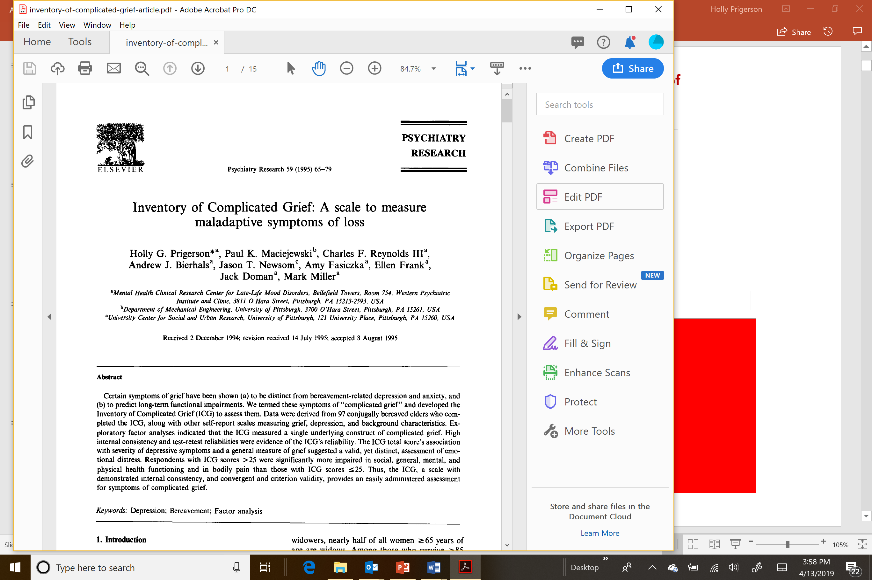
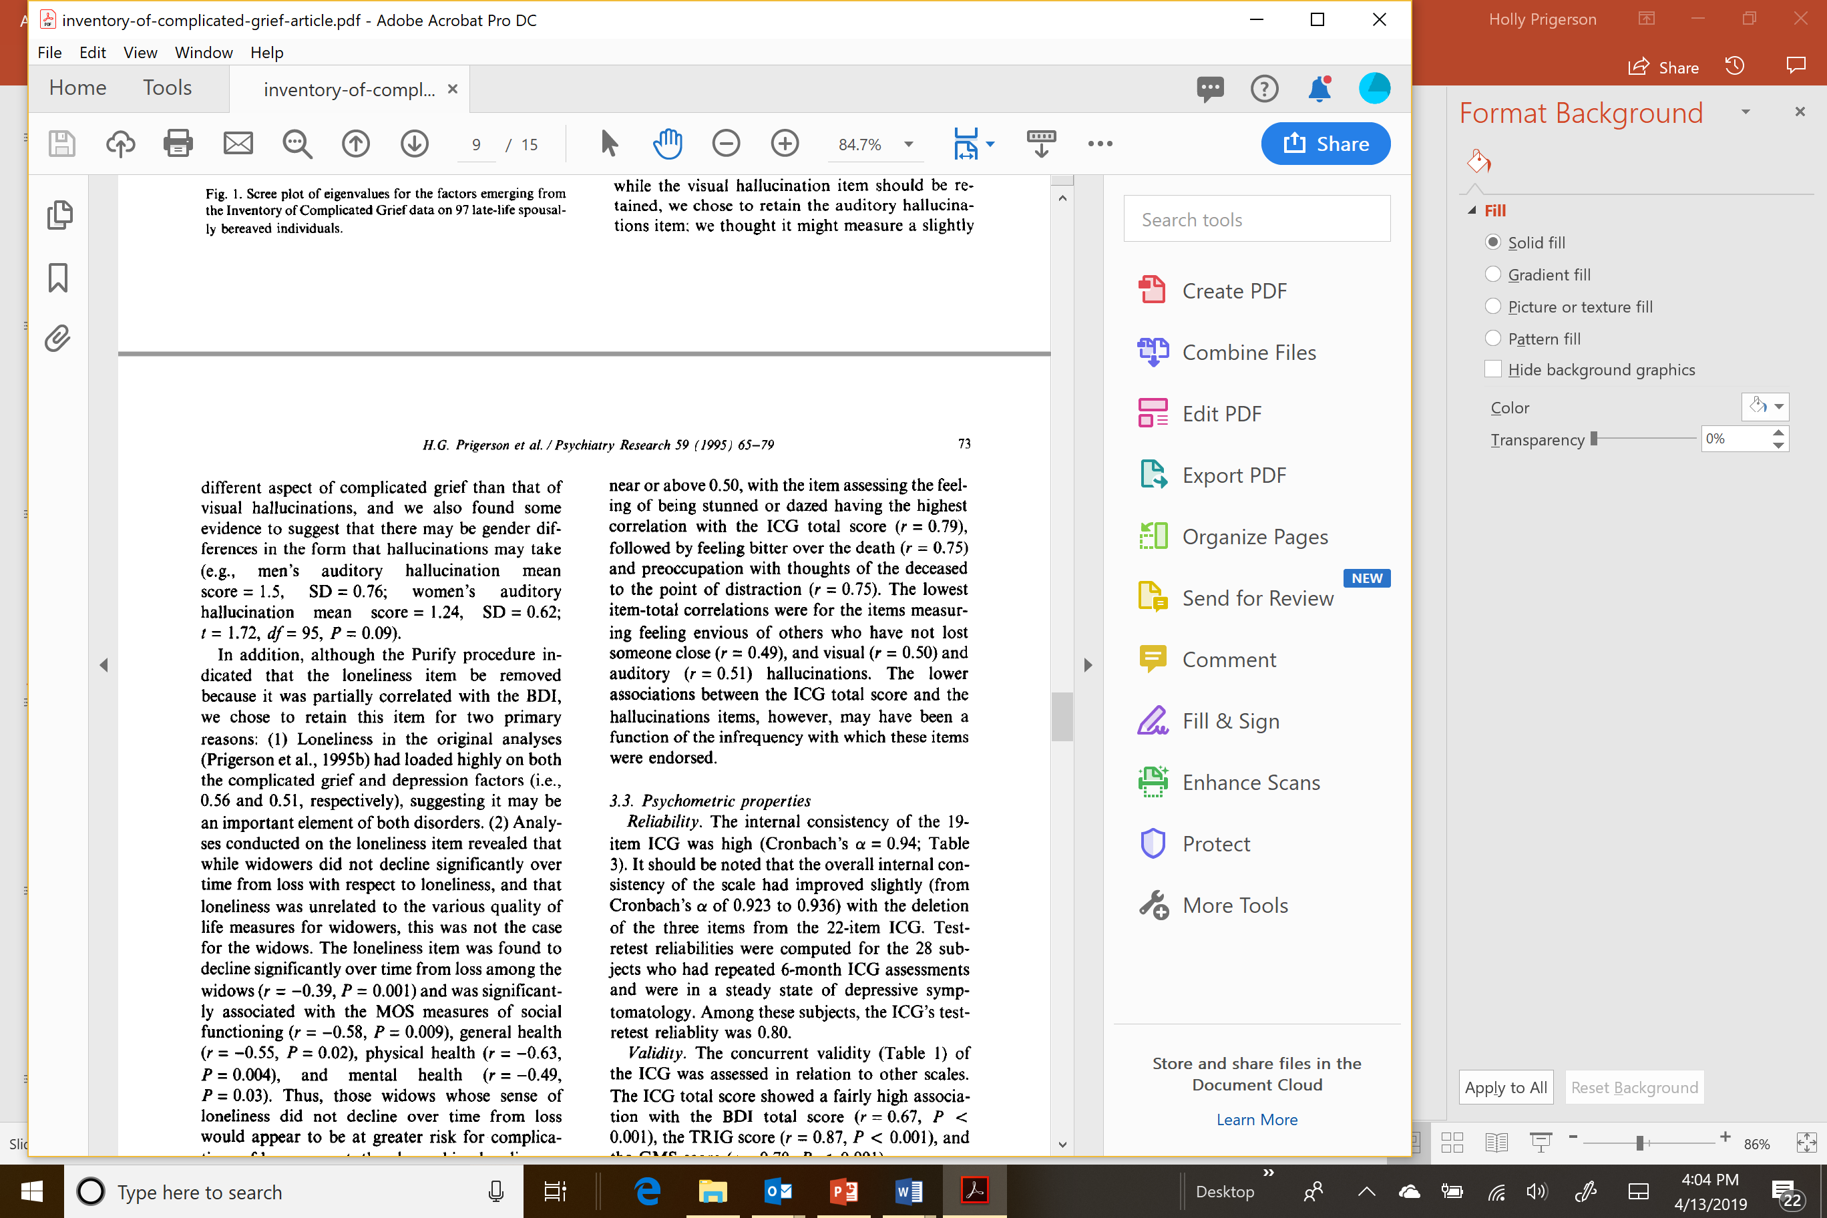
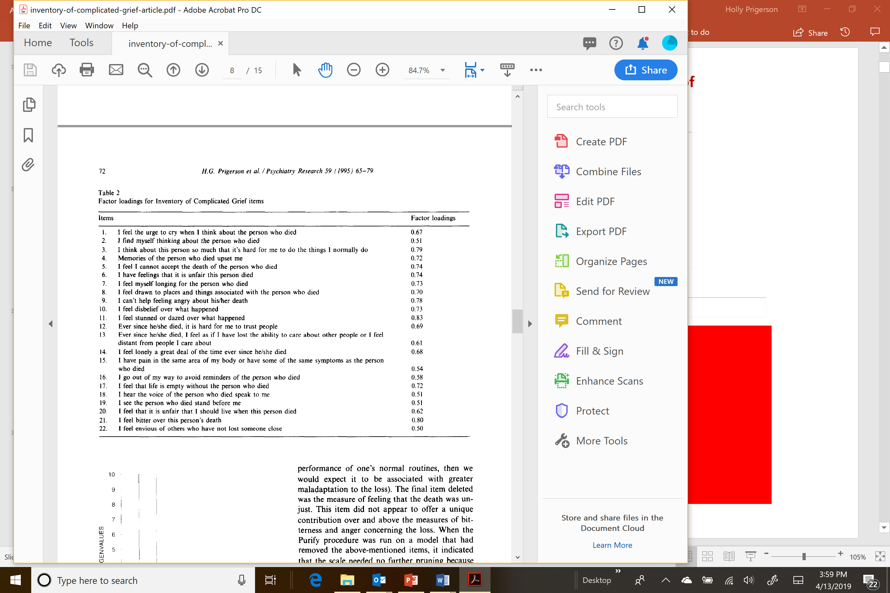
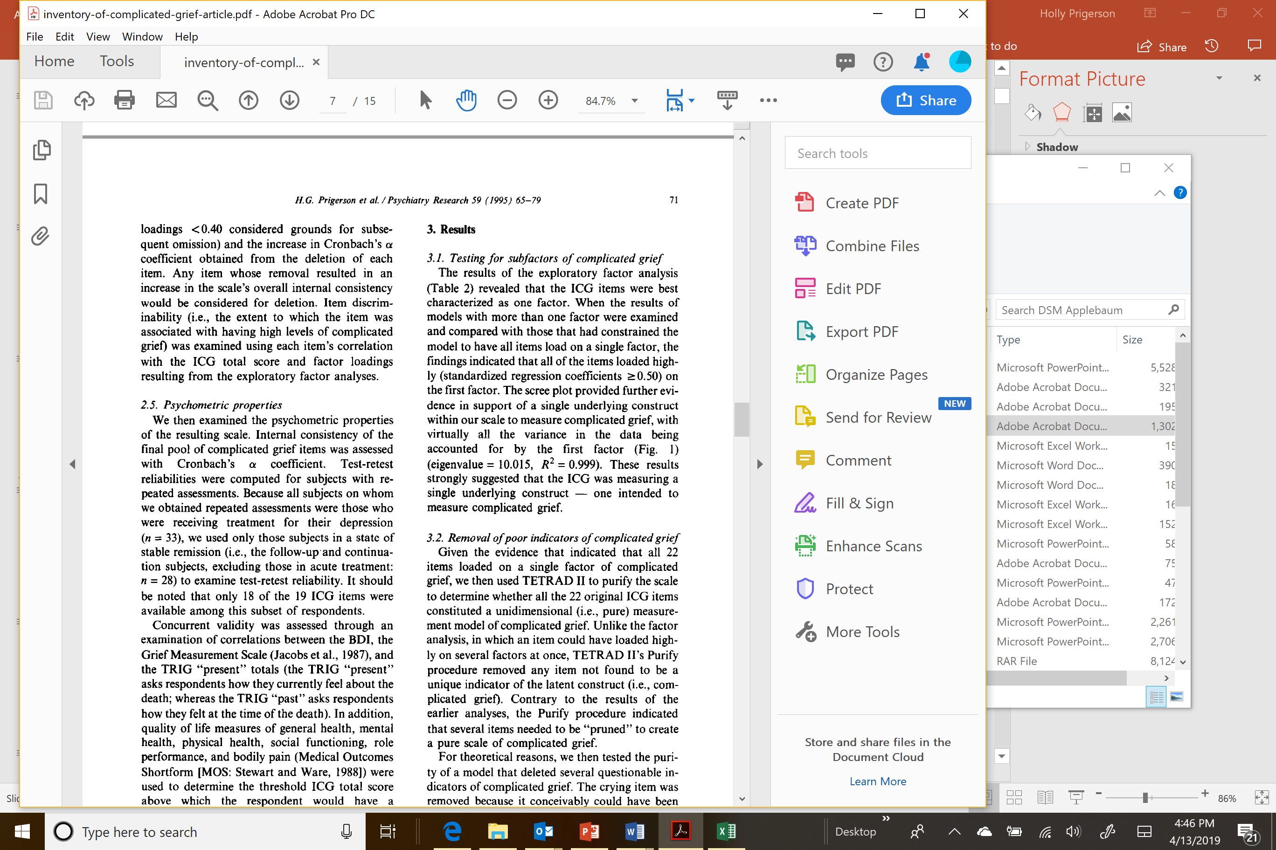
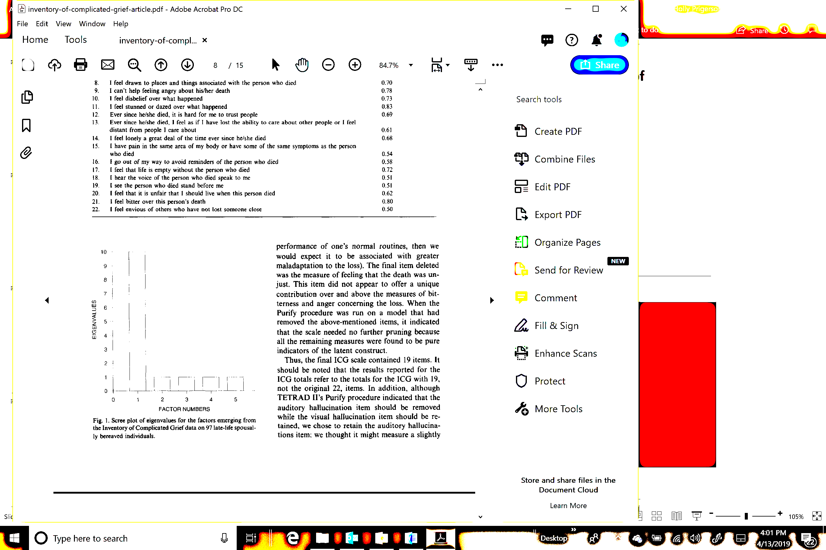
Question #2: Are symptoms of grief internally consistent (reliable)?
internal consistency
Notes:
Iranian test retest after 6 weeks was r=.89.

Slide 9
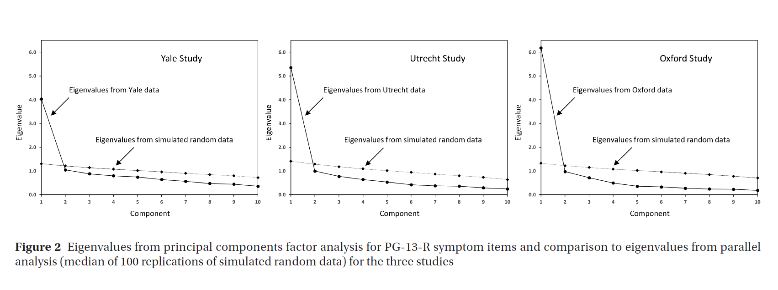
Across studies in the USA, UK, & Netherlands, items form primarily one factor
Prigerson, Xu, Smith, Boelen, Maciejewski, World Psychiatry 2021

Slide 10
Question #3:
What is the evidence of PGD’s validity?

Slide 11
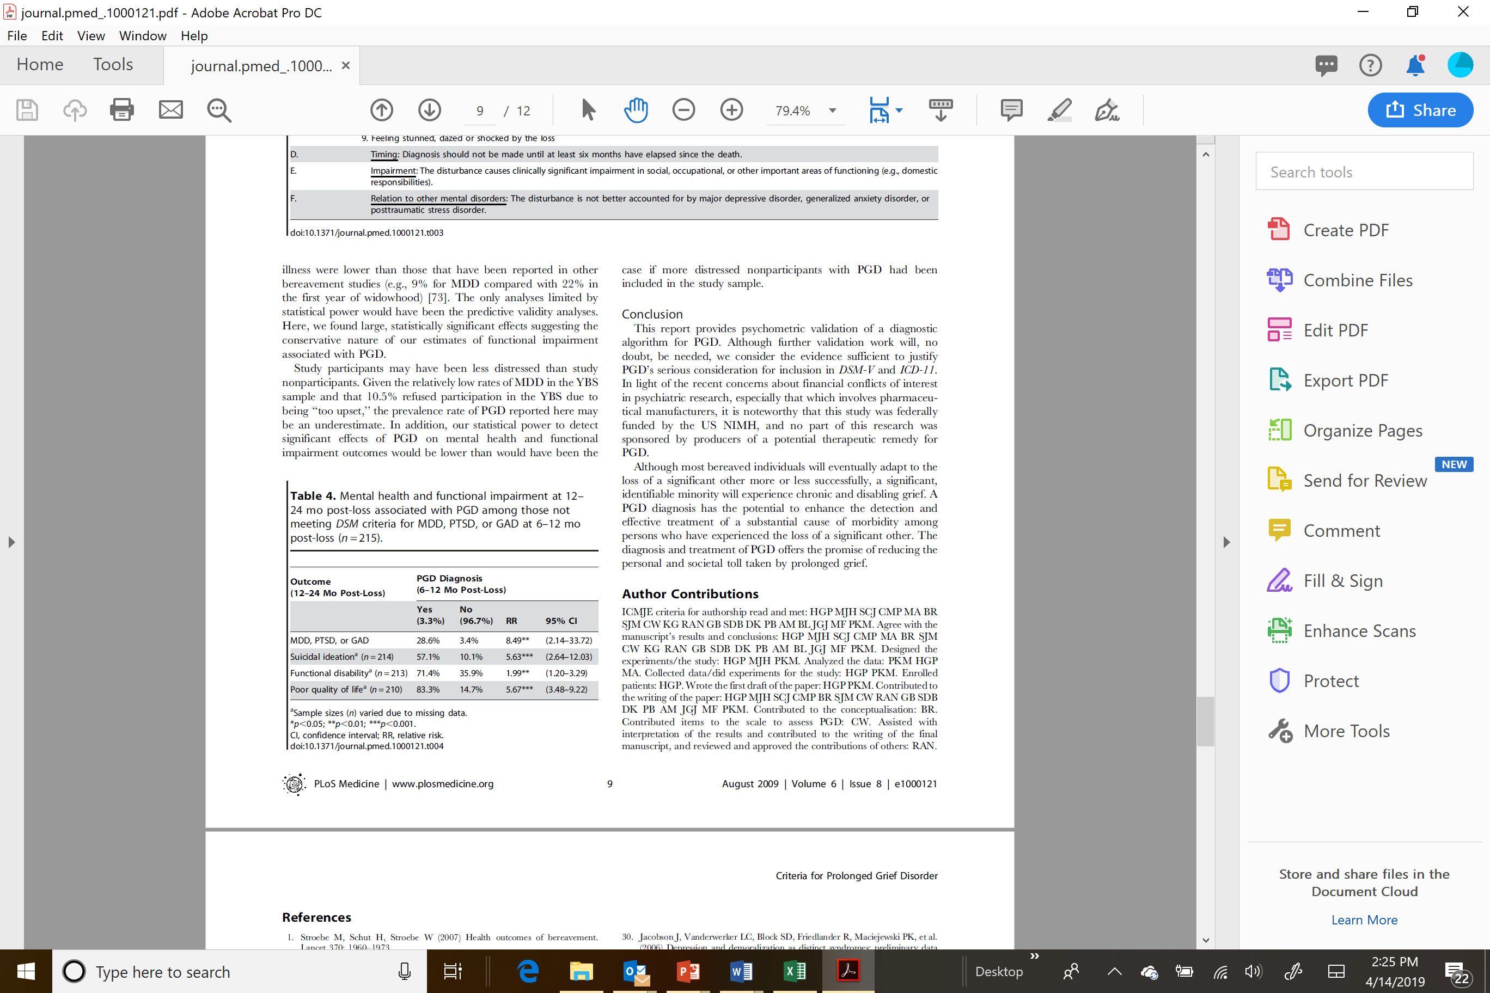
PGD – (Incremental) Predictive Validity
Prigerson et al., PLoS Med 2009
predictive validity

Slide 12
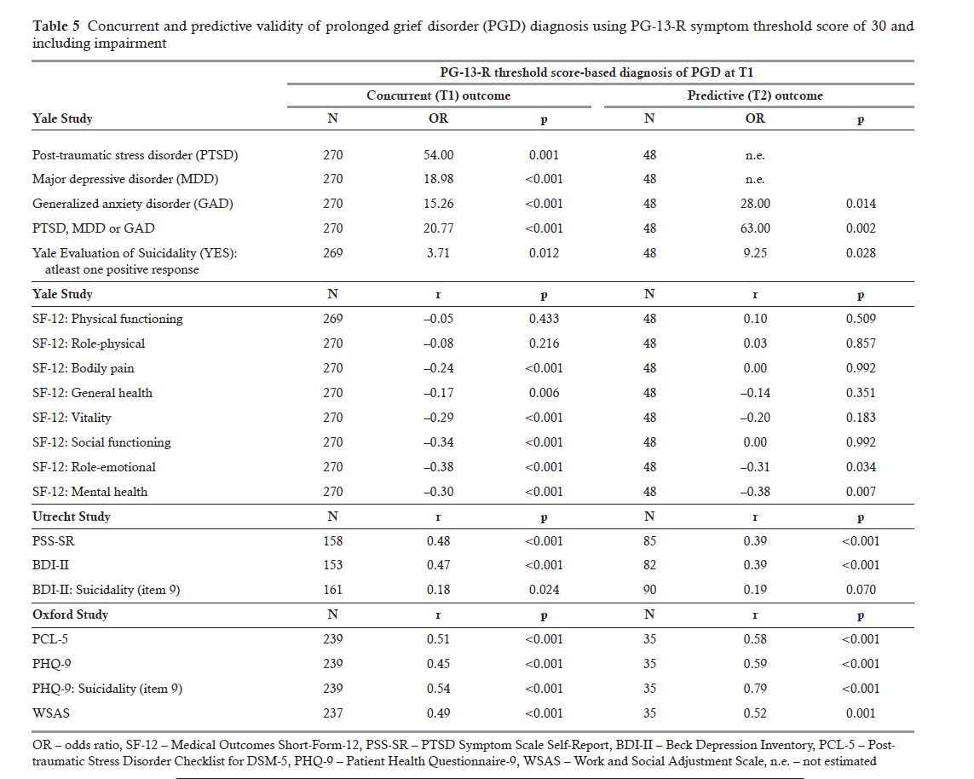
PGD – (Incremental) Predictive Validity
Prigerson, Xu, Smith, Boelen, Maciejewski, World Psychiatry 2021
predictive validity

Slide 13
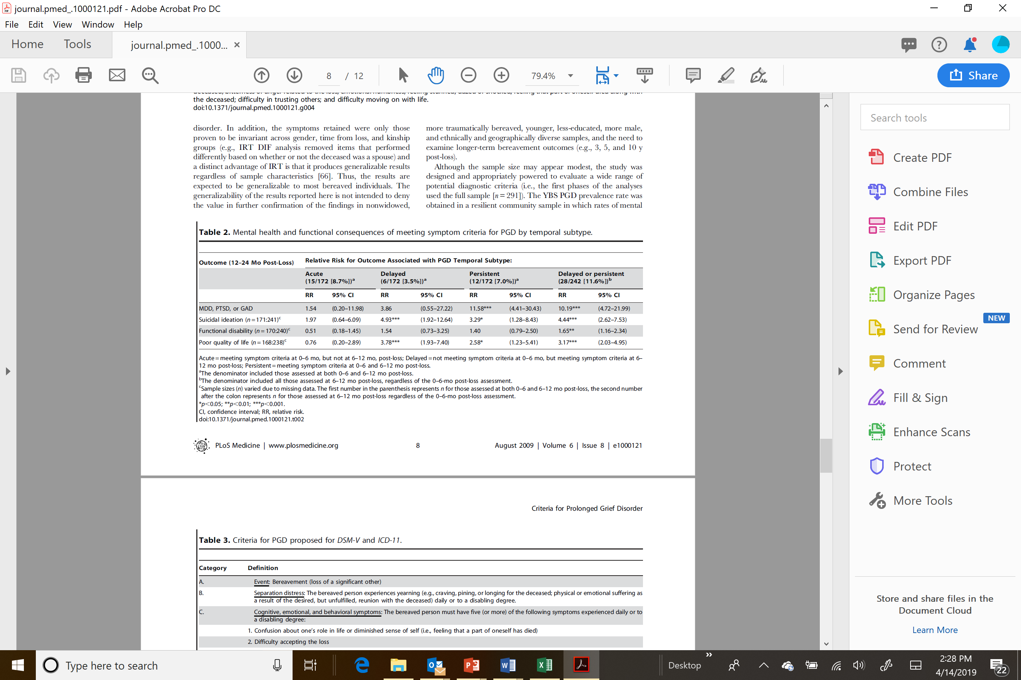
Comparing Temporal Subtypes to Determine
6-months Criterion for PGD
6-months post-loss Point Prevalence = 11.6%
temporal subtypes

Slide 14
I.c. What are the DSM-5-TR criteria for PGD?

Slide 15
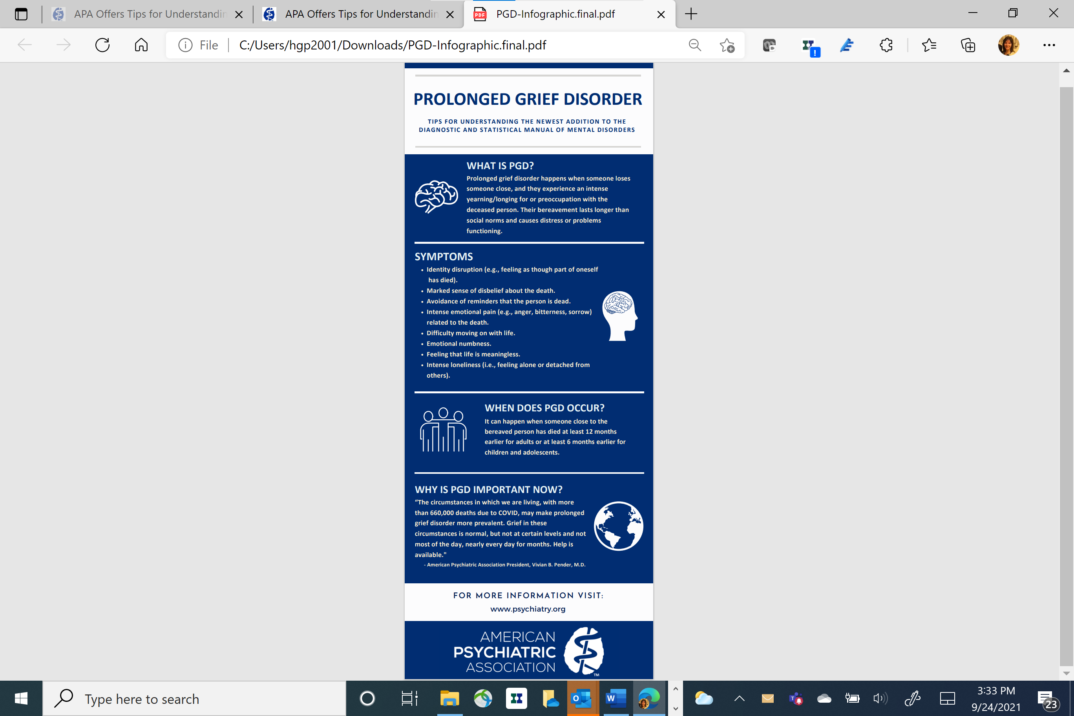
APA Sept 23, 2021 Press release:

Slide 16

What is Prolonged Grief Disorder?
Chronic, intense, distressing reaction to loss distinct from bereavement-related depression and anxiety
Unlike normal grief, individuals with PGD appear to be “stuck” in their grief, yearning intensely for deceased, emotionally numb/detached, identity disturbance, protesting the reality of the loss
Prevalence is <4% following normal circumstances of loss

Slide 17
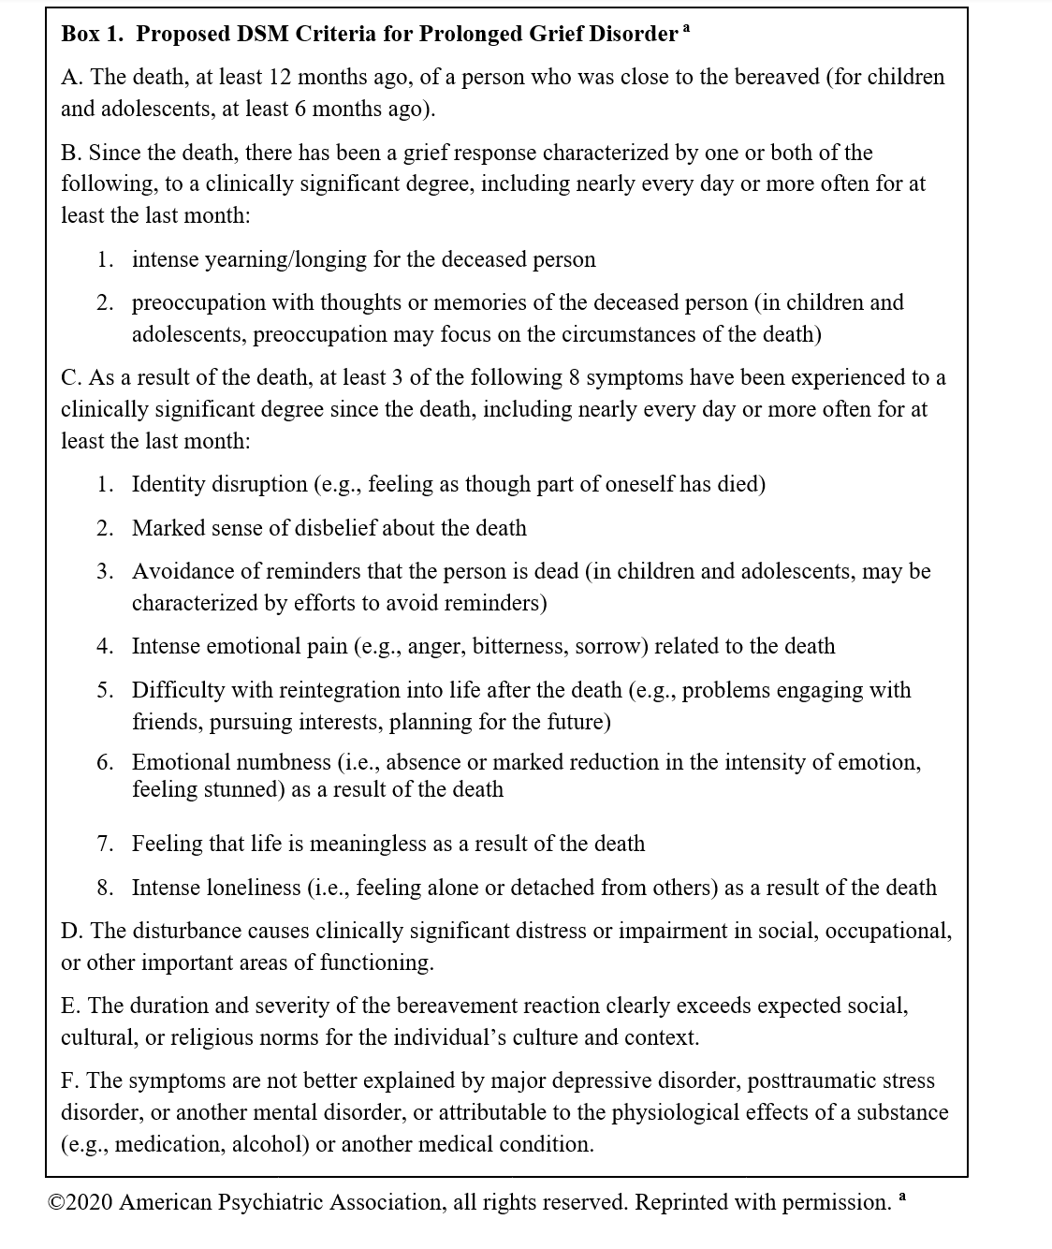
PGD DSM Criteria
Death of close other 12 months
ago
Nearly every day in last month to
clinically significant degree:
yearning; preoccupation
3. 3/8: ID disruption; disbelief,
avoidance; emotional pain/anger;
difficulty reintegrating into life;
emotional numbness;
meaninglessness, loneliness
4. Impairment

Slide 18

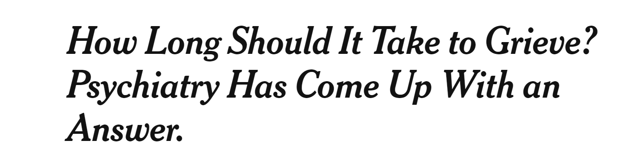
I.d. Misconceptions about PGD
1. PGD diminishes family support, stigmatizes mourners, &
medicalizes grief to push unwanted treatment
2% said family would be less understanding if given PGD dx
> 90% patients think family/friends would be more understanding if diagnosed w/ PGD
96% would be “relieved to know [they] were not going crazy” & 96% “relieved that they had a recognizable problem”
100% meeting PGD dx criteria would be interested in treatment
Johnson et al. Death Studies 2009

Slide 19
Misconceptions about PGD
2. PGD criteria too easy to meet, thus pathologizes normal grief
dx criteria are hard to meet, only 38 of 2498 (4%) German bereaved sample met criteria -- only 1% of the full sample
dx criteria have 1.4% false positive rate
dx criteria require severe distress & impairment
dx criteria predictive of suicidality & MDD, bodily pain, worse general health, vitality, social & role function, heart attacks
Rosner et al. JAD, 2021; Maciejewski et al. World Psychiatry, 2016

Slide 20
Misconceptions about PGD
3. Evidence for PGD is thin
  >600 peer-reviewed articles; 10 systematic reviews in past
  5 Years
  Ample evidence of validity & reliability (e.g., Prigerson et al.
  World Psychiatry 2021 analysis of 3 international, independent
  bereaved samples)
No such thing as stages of grief; time heals all wounds…
  Not ALL wounds heal. Some leave scars, some mourners get stuck…

Slide 21
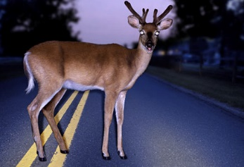

Psychological responses to loss over time
Kubler-Ross’ Stage Theory of (“Normal”) Grief:
Disbelief, Anger, Bargaining, Depression, Acceptance (DABDA)
Anger
Bargaining
Depression
Disbelief
“deer in headlights”
shocked/stunned
Acceptance
“frog in boiling water”/resignation
“back in the saddle”/reintegration
Notes:
The boiling frog is a fable describing a frog being slowly boiled alive. The premise is that if a frog is put suddenly into boiling water, it will jump out, but if the frog is put in tepid water which is then brought to a boil slowly, it will not perceive the danger and will be cooked to death.

Slide 22
For prototypical bereavement -- late-life widowhood after natural death …
Yale Bereavement Study Tested Stage Theory of Grief (Maciejewski et al. JAMA 2007)
Most bereaved people accept death, even initially
Acceptance increases with time from loss
On scale where:
1= < 1/mo; 2= monthly; 3= weekly; 4=daily; 5= > 1X/day

Slide 23
Maciejewski, Zhang, Block, Prigerson JAMA 2007
Notes:
Absolute levels

Slide 24
Maciejewski, Zhang, Block, Prigerson JAMA 2007
Notes:
comparison of peak for each indicator when rescaled 0-1

Slide 25
But that’s normal/typical grief resolution.
A subset of extreme cases of bereaved individuals become stuck…

Slide 26
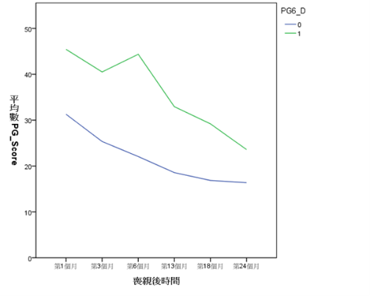
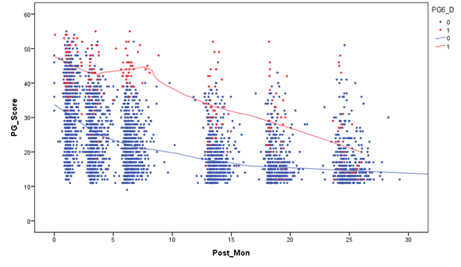
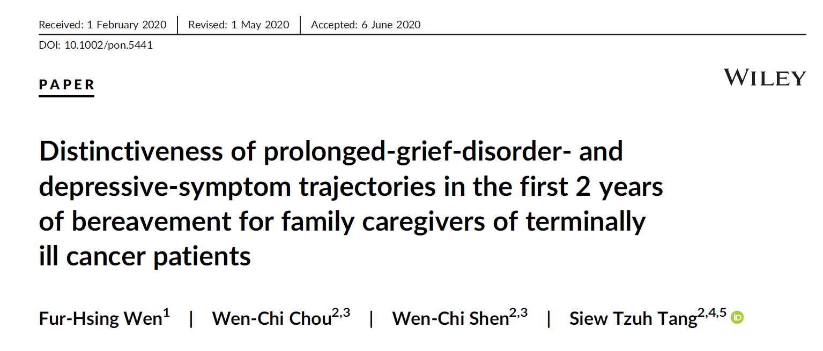
Taiwanese Study found…
Methods: PGD symptoms were measured for 849 cancer patients’ caregivers over their first 2 years of bereavement

Slide 27
II. A micro-sociological theory of adjustment to loss

Slide 28
Aristotle famously wrote:
“nature abhors a vacuum”
The phrase expresses the idea that unfilled spaces go against the laws of nature and physics and that every space needs to be filled with something.
Does the same hold true for the “social space” created by an interpersonal loss?

Slide 29
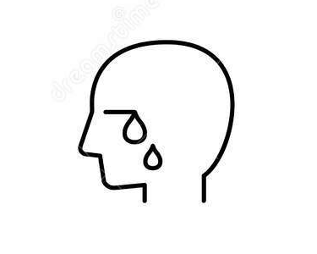
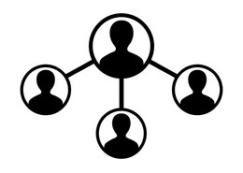

Figure 1. A Conceptual Model Relating the Satisfaction of Psychosocial Needs to
Bereavement Adjustment
Bereavement Psycho-social Needs Adaptation to Loss
Social Deprivations
Lost sense of:
Belonging and connectedness to others
To not be a burden on others
Caring and nurturance of others
Safety and security evoked by others
Identity and role clarification in relation to others
Feeling understood by other
Feeling appreciated, valued, and loved by others
Appreciating, valuing, and loving others
Bereavement Outcomes
Mental health
  Prolonged Grief Disorder
  Suicidal Thoughts & Behaviors
Mourner
Maciejewski PK, Falzarano FB, She WJ, Lichtenthal WG, Prigerson HG. A micro-sociological theory of adjustment to loss. Curr Opin Psychol. 2022 Feb;43:96-101.
¹ Maciejewski, P. K., Falzarano, F. B., She, W. J., Lichtenthal, W. G., & Prigerson, H. G. (2021). A micro-sociological theory of adjustment to loss. Current opinion in psychology, 43, 96–101. Advance online publication. https://doi.org/10.1016/j.copsyc.2021.06.016

Slide 30
Interventions targeting psychosocial deprivations
identified in the micro-sociological theory of
adaptation to loss:
Living Memory Home
Finding My Way

Slide 31
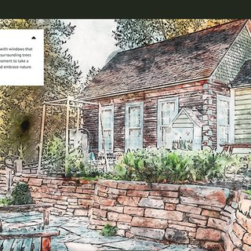
Living Memory Home
Online place to create & store memories of the dying or deceased person
Online journal with prompts to promote positive sharing (e.g., “what I always admired about you was…”; “I always wanted to tell you…”)
Dementia “care pairs” an activity to document sources of pride & joy before too late
Bereaved caregivers a place to maintain continuing bonds; text monitored by machine learning algorithm to detect those with significant suicidal risk

Slide 32



Figure 1. Conceptual Model of Psychosocial Deprivations Targeted by the Living
Memory Home to Reduce Grief & Improve Relationship Quality in Dementia “Care Pairs”
TIMELINE
Baseline Psychosocial Mediators + 1 month Post-loss______
Pre-loss Grief
Psychosocial Targets
Social isolation
Sense of belonging
Sense of being appreciated
Identity
Self-esteem
Role clarification
Respect for PwD
Nurturance of PwD
Bereaved Outcomes
PGD
MDD
regret
Living Memory
Home
Caregiver-PwD
Relationship Quality

Slide 33
Finding My Way
Online tool that includes:
  LMH journaling
  Cognitive reframing of negative bereavement cognitions exercises
  Social mapping
  Social skills training
  Simpatico “connecting with others” match-making algorithm connecting “like” (cause of death, kinship, interests) bereaved others

Slide 34


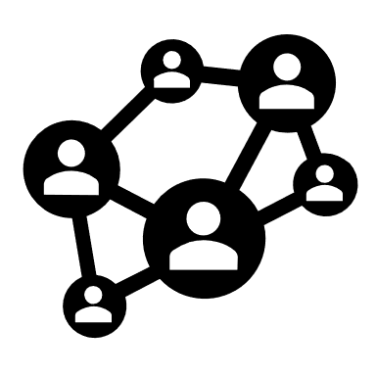
Figure 1. Conceptual model of how Finding My Way components relate to targets
expected to prevent onset of Prolonged Grief Disorder (PGD) & Suicidal Thoughts & Behaviors (STBs) in bereavement
TIMELINE
Baseline Psychosocial Targets @ 1 month Bereavement Outcomes @ 1 year
Living Memory
Home
Meaning-Making
Prolonged Grief Disorder
Social Connectedness
Suicidal Thoughts & Behaviors
Connecting with Others

Slide 35
III. Treatment implications
a) EMPOWER
b) Naltrexone

Slide 36
III. a) Motivation behind our EMPOWER intervention
Critical illness can put both patients and caregivers at risk for psychological distress
Psychological burden may be especially great for surrogate decision-makers (e.g., family caregivers) of incapacitated dying patients in the ICU; further exacerbated by COVID-19 social distancing restrictions
Need to help these family caregivers in coping with this extremely psychologically distressing situation

Slide 37

EMPOWER: Enhancing & Mobilizing the POtential for Wellness & Emotional Resilience
An intervention to empower surrogates with tools, psychoeducation, & experiential exercises
6 ultra-brief (~15- to 20-minute) modules (total time: ~1.5 – 2 hours) administered flexibly to accommodate interruptions and crises during the patient’s ICU stay
May be delivered in a single session or 2-3 briefer sessions, with 2 booster calls
Incorporates cognitive-behavioral, acceptance-based, and grief therapy meaning-centered therapy techniques to assist with coping

Slide 38
The EMPOWER Intervention
In ICU/ Telehealth | Delivered in single or multiple sessions | Module 1 | Nurturance, Understanding, and Joining
 |  | Module 2 | Breathing Retraining, Grounding Exercises, and Mindfulness Meditation
 |  | Module 3 | Psychoeducation about Trauma, Grief, and the Cognitive-Behavioral Model
 |  | Module 4 | Increasing Acceptance and Sense of Permission to Experience Challenging Emotions
 |  | Module 5 | Connecting with the Patient’s Voice
 |  | Module 6 | Using the EMPOWER Toolbox and Coping Rehearsal
Phone/ Telehealth | 2 weeks post-Module 6 | Booster Call 1 | Check-in and review of psychoeducation and coping skills
Phone/ Telehealth | 4 weeks post-Module 6 | Booster Call 2 | Check-in and review of psychoeducation and coping skills
[MV1]Chris Cox suggested a table explaining the EMPOWER intervention and Maddie came up with this. What do you think?
[HP2]I think it’s great!

Slide 39


EMPOWERing Surrogates to Cope by Reducing Experiential Avoidance
Patient
ICU Admission
Timeline
Caregiver Mental Health 1 & 3 Months from T1/Baseline
Experiential Avoidance
Improved Mental Health
Surrogate
Decision Maker
Pre-Loss Grief
Anxiety
Family Surrogate
Reduced peri-traumatic distress
Reduced PGD and anxiety symptom severity
Increased acceptance
EMPOWER
Acknowledges potentially traumatic
situation
Engages in mindfulness, breathing, &
grounding exercises
Provide psychoeducation re: peri-
traumatic stress, anticipatory grief,
& experiential avoidance
Reviews CBT & ACT strategies to
build distress tolerance
Invokes patient’s values for role-play
EMPOWER = Enhancing & Mobilizing the POtential for Wellness & Emotional Resilience
PTSD = Posttraumatic Stress Disorder
PGD = Prolonged Grief Disorder

Slide 40
Preliminary Results
Measure | Post-intervention |  | One-month Follow-up |  | Three-month follow-up
 | n | Cohen’s d | n | Cohen’s d | n | Cohen’s d
Grief Intensity (PG-12/13) | 20 | -1.39 | 16 | -1.57 | 15 | -1.20
State Anxiety (STAI) | 16 | -0.58 | 11 | 0.93 | 10 | 0.12
Depression (PHQ-9) | - | - | 17 | -0.89 | 17 | -0.74
Peritraumatic Distress (PDI) | 17 | -0.16 | 12 | 0.04 | 11 | -0.22
Traumatic Stress (IES-R) | 11 | -0.45 | 10 | -1.40 | 10 | -0.99
Experiential Avoidance (BEAQ) | 25 | -0.25 | 18 | -0.89 | 18 | -1.20
Decision Regret (DRS) | 8 | -1.38 | 8 | -0.73 | 6 | -1.57
Large
Large
Large
Moderate
Not maintained
Not maintained
Large
Moderate-Large
No effect
No effect
Small
Small-Moderate
Large
Large
Small
Large
Large
Large
Moderate-Large
Large
Note. Between-groups Cohen’s d comparing EMPOWER to EUC.

Slide 41
Participant Exit Interview Feedback
“It wasn't something I was really looking forward to or looking to when I didn't think it was going to be helpful for me at the time because there's so much on my mind. But after being placed in the room and having to actually talk about it when I barely had time - - to eat or - - let alone think about oh I should get to therapy. It wasn't something I was actually thinking of. But at the end of the day it really--I don't want it to feel overdramatic in saying, like, it saved my sanity. But it really did, you know, really did give me a support that I didn't really think I needed until everything--until I actually did it and then I realized what a weight off my shoulders it felt like to be able to talk about it… So, you know, I sat down and asked questions about things right in the hospital - - kind of if I had to I just go out and take care of something with my mother. So it was very helpful. I can't express how helpful it was.” -EMPOWER1

Slide 42
III. b) Motivation for our Naltrexone Trial
Established therapies for bereavement-related depression – TCAs & IPT – not work for PGD sxs
PGD is characterized by yearning for deceased
Nucleus accumbens activation linked to yearning specific to deceased person
Naltrexone blunts yearning for rewarding stimulus, which should free mourner from grips of grief & promote openness to others

Slide 43
The Naltrexone Trial
Prior to
Enrollment
Total n = 80: Phone screen potential participants by inclusion and exclusion criteria
Visit 1
Day 0/Wk 1
Obtain Informed Consent
Screen: SCIP, C-SSRS, Medical History, Review of Medications
Arm 1 (Naltrexone)
n = 40
Arm 2 (Placebo)
n = 40
Visit 2
Day 28/Wk 4
Perform baseline assessments
Dispense 8-week supply of medication
Follow-up
Day 84/Wk 12
Follow-up assessments

Slide 44
In conclusion, we have …
I. Discussed PGD’s
a) backstory
b) summarized psychometric support for DSM-5-TR inclusion
c) shared diagnostic criteria
d) refuted misconceptions
Presented our micro-sociological theory of adjustment to loss
a) provided some examples of applications in online
interventions
III. Discussed some novel PGD interventions
a) EMPOWER
b) naltrexone

Slide 45
Conclusion
THANK YOU FOR YOUR ATTENTION.
I wish to acknowledge the contributions of Paul Maciejewski,
Wendy Lichtenthal, and Francesca Falzarano in support of
this work and thank Hillary Winoker for her assistance with
preparation of these slides.
Please contact me at:
hgp2001@med.cornell.edu
with your feedback.
THE END

Slide 46
Extra slides

Slide 47
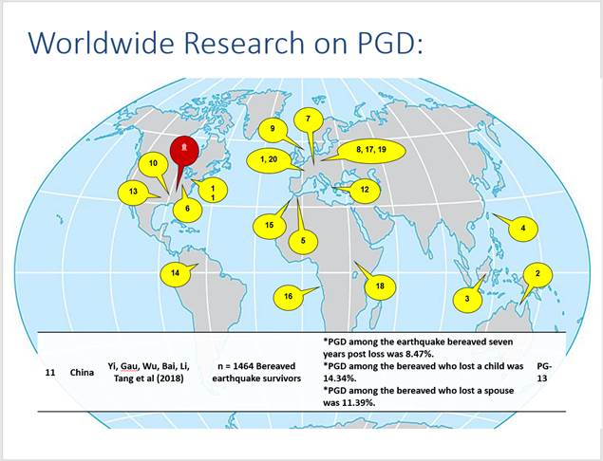
I.b.6) Validated Cross-culturally

Slide 48

Worldwide Research on PGD using PG-13:
16
15
۩
17
2, 7, 19
12, 13
18
1, 14
8
23
3
20, 22
21
4, 5, 9
6, 10, 11
19
N E X T
cross-cultural validation

Slide 49
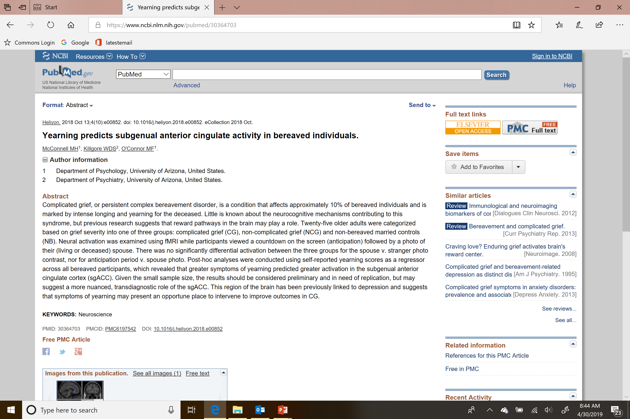
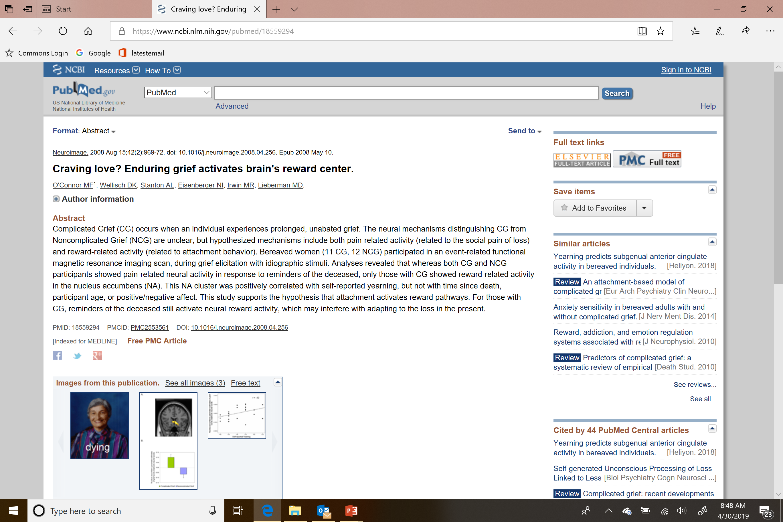
Yearning = Grief

Slide 50
Evolution of Definition of Prolonged Grief Disorder in ICD-11
Maercker et al. (2013)
ICD-11 (2018)
A disturbance in which, following the death of a person close to the bereaved, there is persistent and pervasive yearning or longing for the deceased, or a persistent preoccupation with the deceased that extends for an abnormally long period beyond expected social and cultural norms (e.g., at least 6 months, or longer depending on cultural and contextual factors) and that is sufficiently severe to cause significant impairment in the person’s functioning. The response can also be characterized by difficulties accepting the death, feeling one has lost a part of one’s self, anger about the loss, guilt, or difficulty in engaging with social or other activities.
Prolonged grief disorder is a disturbance in which, following the death of a partner, parent, child, or other person close to the bereaved, there is persistent and pervasive grief response characterized by longing for the deceased or persistent preoccupation with the deceased accompanied by intense emotional pain (e.g. sadness, guilt, anger, denial, blame, difficulty accepting the death, feeling one has lost a part of one’s self, an inability to experience positive mood, emotional numbness, difficulty in engaging with social or other activities). The grief response has persisted for an atypically long period of time following the loss (more than 6 months at a minimum) and clearly exceeds expected social, cultural or religious norms for the individual’s culture and context. Grief reactions that have persisted for longer periods that are within a normative period of grieving given the person’s cultural and religious context are viewed as normal bereavement responses and are not assigned a diagnosis. The disturbance causes significant impairment in personal, family, social, educational, occupational or other important areas of functioning.

Slide 51
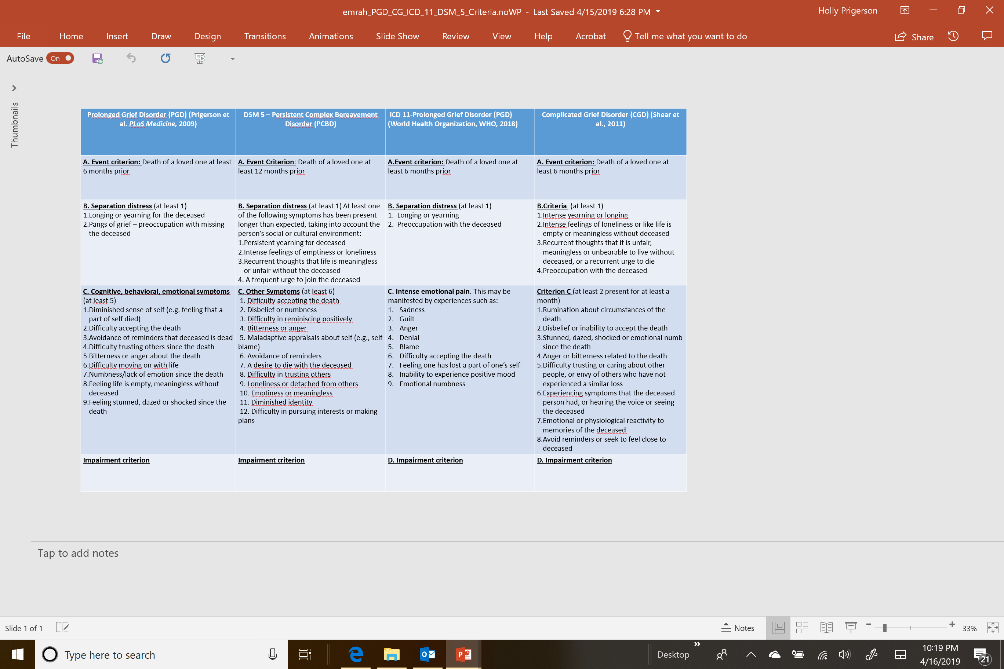
II.a) Problems with symptoms of PCBD, CG, ICD-11
problems with symptoms, thresholds
Notes:
PCBD and CG do not require yearning; they include symptoms of depression and suicidal ideation and anxiety (physiological reactivity); the syntax is off – avoid reminders and seek to feel close = avoid reminders of reality of the loss;

Slide 52
Rates of Diagnosis by Competing Algorithms in Two Studies:
Yale Bereavement Study (YBS) and National Military Family Bereavement Study (NMFBS)
20%
95% CI
Lundorff et al. (2018)
10%
YBS
NMFBS
YBS
NMFBS
YBS
NMFBS
YBS
NMFBS
Prolonged Grief
Disorder (PGD)
Complicated
Grief (CG)
DSM-5
(PCBD)
ICD-11
(PGD)

Slide 53
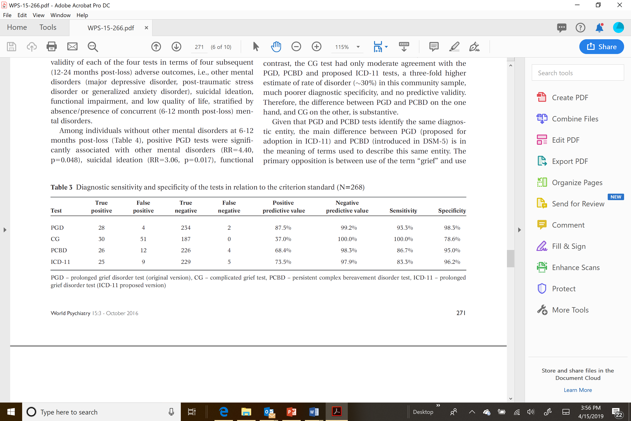
II.b) Psychometric Performance
Maciejewski et al. World Psychiatry 2016
psychometric performance

Slide 54
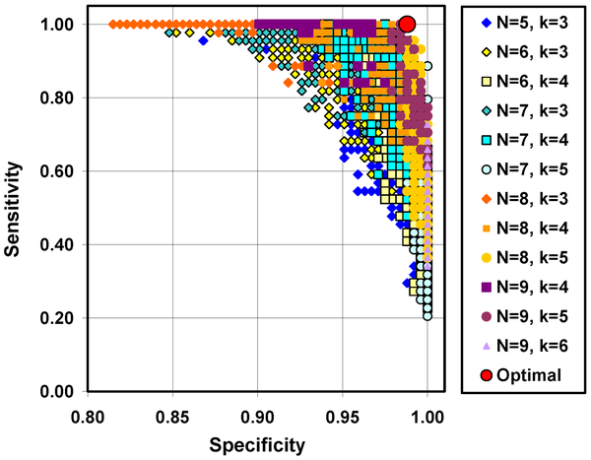

Figure 4. Alternative diagnostic algorithms for meeting symptom criteria for PGD.
Prigerson HG, Horowitz MJ, Jacobs SC, Parkes CM, Aslan M, et al. (2009) Prolonged Grief Disorder: Psychometric Validation of Criteria Proposed for DSM-V and ICD-11. PLOS Medicine 6(8): e1000121. https://doi.org/10.1371/journal.pmed.1000121
https://journals.plos.org/plosmedicine/article?id=10.1371/journal.pmed.1000121
psychometric evaluation

