Slide 1
How the DSM can improve upon the ICD in Defining Prolonged Grief Disorder (PGD)
Holly G. Prigerson, PhD
Irving Sherwood Wright Professor of Geriatrics
Professor of Sociology in Medicine
Weill Cornell Medicine
Co-Director, Center for Research on End-of-Life Care
Cornell University
Paul K. Maciejewski, PhD
Associate Professor of Biostatistics in Radiology
Associate Professor of Biostatistics in Medicine
Weill Cornell Medicine
Co-Director, Center for Research on End-of-Life Care
Cornell University

Slide 2
Origins of DSM-5’s Persistent Complex Bereavement Disorder (PCBD)
As Matthew Friedman, MD, PhD, chair of DSM-5’s Sub-Workgroup on Trauma-/
Stress-Related and Dissociative Disorders, wrote in the AJP (2016)…
“… the DSM-5 sub-workgroup … had two overlapping but different … criteria for an abnormal grief reaction…
… they [the DSM-5 sub-workgroup] did not believe that they could or should choose between prolonged grief disorder and complicated grief…
As a result, persistent complex bereavement disorder was …constructed as an amalgam of all of the symptoms … in … prolonged grief disorder or complicated grief and placed in DSM-5’s section III …”
Thus, DSM-5 decided to defer actual naming of the disorder and specification of its criteria

Slide 3
Evidentiary Scorecard at Time of DSM-5 Sub-Workgroup (2010)
& Publication of DSM-5 (APA 2013)
Prolonged Grief Disorder
(PGD)
Complicated Grief
(CG)
Domain | Item |  | Yes |  |  | No |  |  | Unknown |  |  |  | Yes |  |  | No |  |  | Unknown
Validity | Construct |  |  | √ |  |  |  |  |  |  |  |  |  |  |  |  |  |  |  | √
 | Concurrent |  |  | √ |  |  |  |  |  |  |  |  |  |  |  |  |  |  |  | √
 | Discriminant |  |  | √ |  |  |  |  |  |  |  |  |  |  |  |  |  |  |  | √
 | Predictive |  |  | √ |  |  |  |  |  |  |  |  |  |  |  |  |  |  |  | √
Measurement | Reliability |  |  | √ |  |  |  |  |  |  |  |  |  |  |  |  |  |  |  | √
 | Sensitivity |  |  | √ |  |  |  |  |  |  |  |  |  |  |  |  |  |  |  | √
 | Specificity |  |  | √ |  |  |  |  |  |  |  |  |  |  |  |  |  |  |  | √
 | Accuracy |  |  | √ |  |  |  |  |  |  |  |  |  |  |  |  |  |  |  | √
Acceptability | Stigma |  |  | √ |  |  |  |  |  |  |  |  |  |  |  |  |  |  |  | √
 | Clinical Utility |  |  |  |  |  |  |  |  | √ |  |  |  |  |  |  |  |  |  | √
Robustness | Cross-Validation |  |  |  |  |  |  |  |  | √ |  |  |  |  |  |  |  |  |  | √
 | Cross-Cultural Validity |  |  |  |  |  |  |  |  | √ |  |  |  |  |  |  |  |  |  | √

Slide 4
PCBD is, therefore, a non-starter – a provisional place-holder amalgam of PGD & CG (despite no evidence in support of CG)
Priority should be on harmonizing and improving on ICD-
11’s PGD…

Slide 5
Origins of ICD-11’s PGD
Killikelly & Maercker (2018) wrote:
“In 2009, a broad group of authors developed a consensus on the criteria for a clinical diagnosis of PGD… [based on] an analysis of [data] from the Yale Bereavement Study (Prigerson et al., 2009)…
[it] generated sensitive and specific items for the PGD-2009 criteria…
… predictive validity (Prigerson et al., 2009) and the diagnostic distinction of PGD have been consistently confirmed…
Based on the important research findings outlined above, with the new refinements by the WHO working group, [we] offer valid and clinically useful diagnostic guidelines for the inclusion of PGD in the ICD-11 …”
Thus, ICD-11 decided to act on evidence supporting PGD criteria

Slide 6
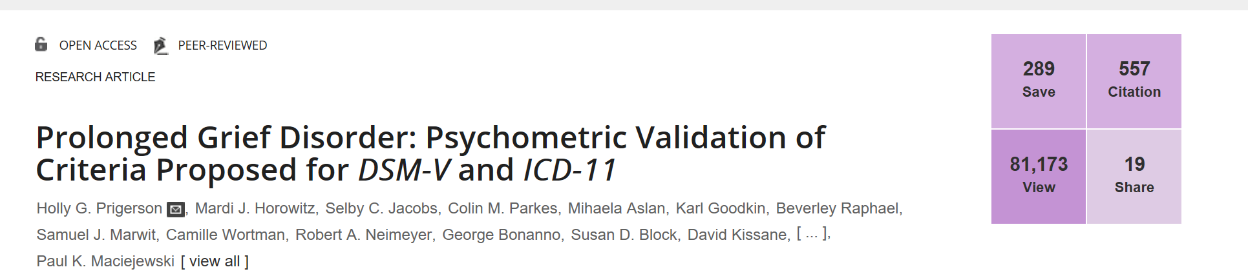
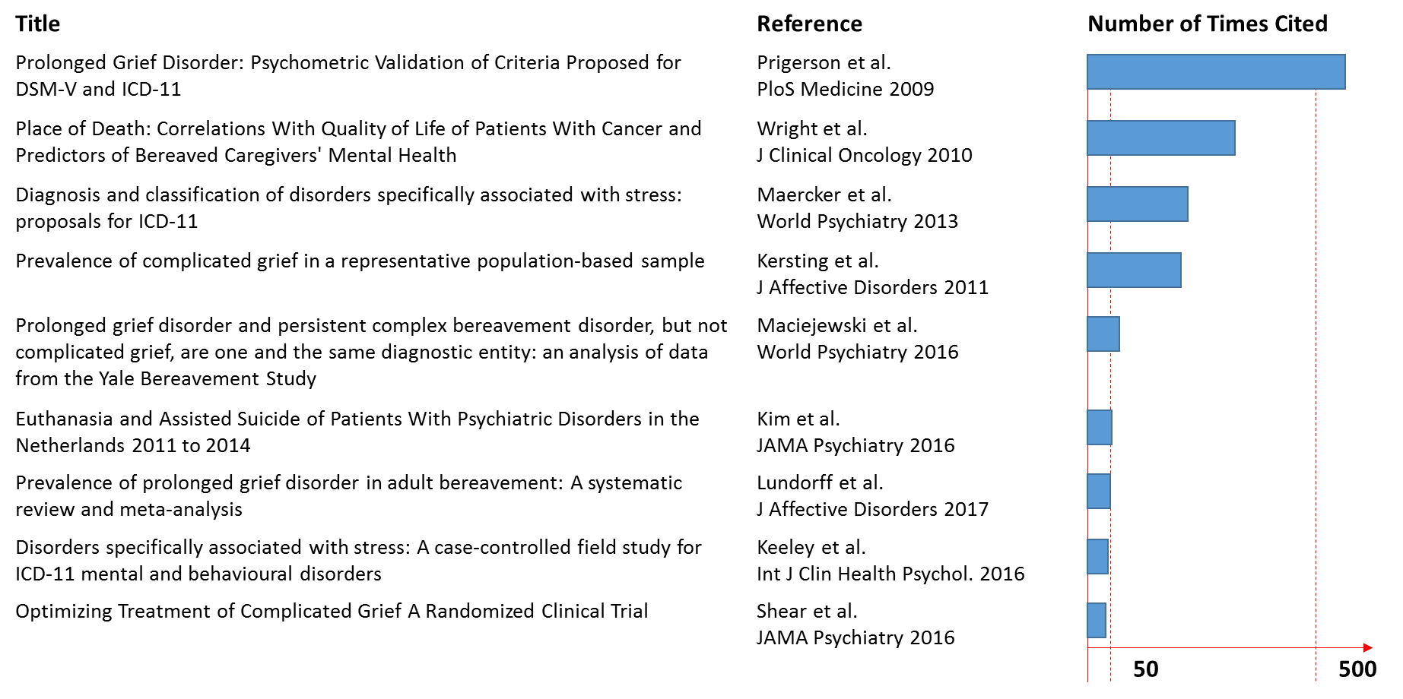
Evidence for ICD-11’s PGD was based mostly on data from Yale Bereavement Study NIMH R01, PLoS Medicine (2009)

Slide 7
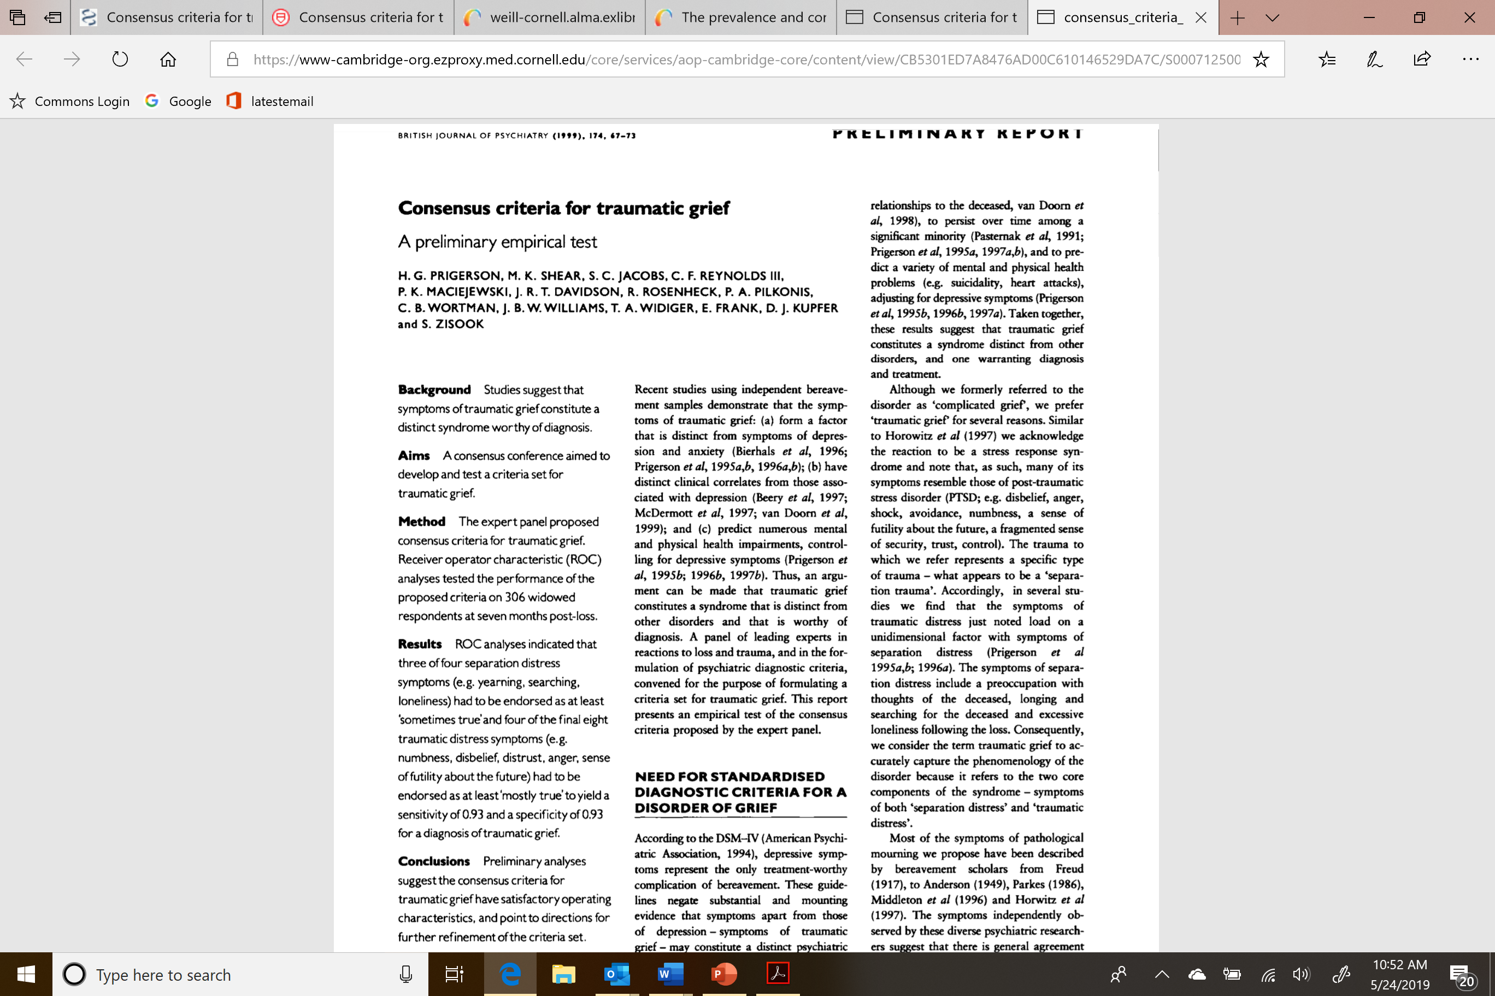
Yale Bereavement Study (YBS)
NIMH R01 Field Trial of PGD Consensus Criteria for DSM-5
1st we published preliminary consensus
criteria in BJP (1999): →
2nd we published their psychometric
validation in PLoS Med (2009): ↓
  Sample: 291 community-based bereaved subjects interviewed longitudinally
  Assessment Schedule: 0-6, 6-12, 12-24 months post-loss

Slide 8
Yale Bereavement Study used Item Response Theory (IRT) to construct a continuous symptom measure
Started with candidate symptoms or “items”
Examined individual items with respect to:
Item Information Function (IIF)
Differential Item Functioning (DIF)
Constructed continuous measure of grief symptoms based on a reduced set of items that proved informative and unbiased

Slide 9
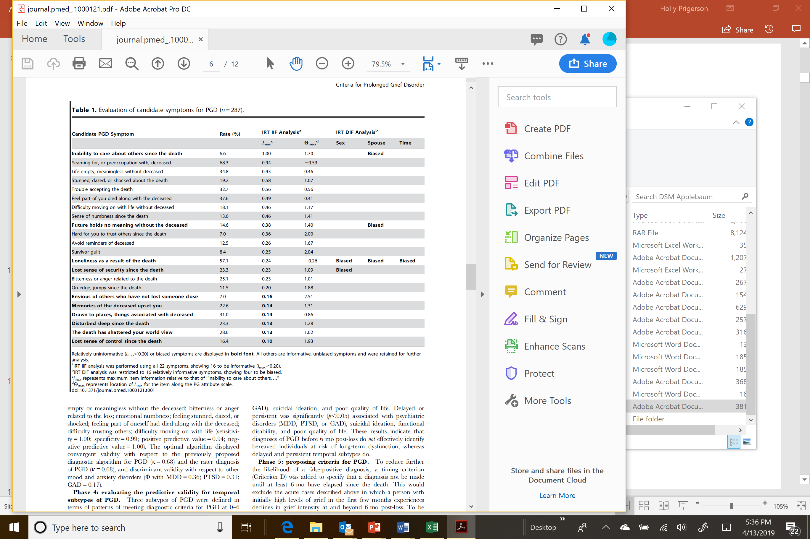
Evaluation of Item Information and Differential Item Functioning

Slide 10
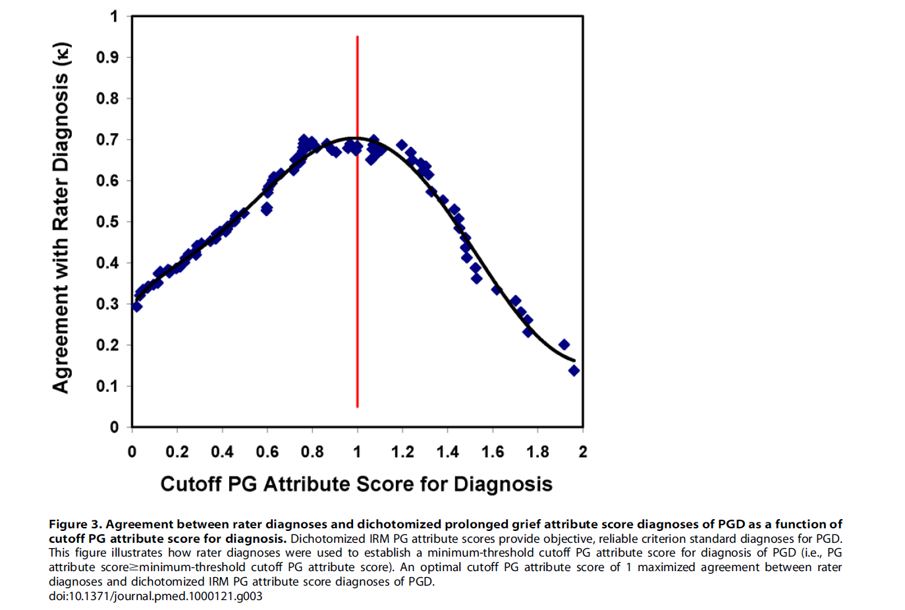
“Criterion Standard” to identify “Cases”
PG Attribute Score
Benefit
  objective
  applied consistently, in standard way
  doesn’t require clinician
Problems
  doesn’t leverage clinical insight
Rater Diagnosis of PGD
Benefit
  reflects best clinical judgment
Problems
  subjective
  inconsistent with underlying grief attribute
Maximize agreement between rater dx and IRT score to determine threshold for dx “cases”

Slide 11
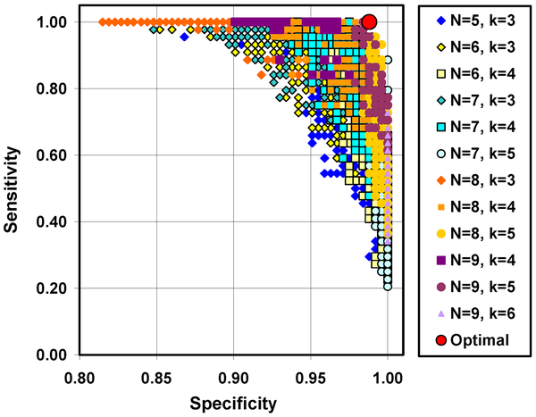
Alternative diagnostic algorithms for meeting symptom criteria for PGD

Slide 12
Optimum Diagnostic Algorithm and Its Properties
Optimum Algorithm
Gateway “B” symptom: Yearning
5 of 9 “C” symptoms: Stunned by the loss, confused about role in life, trouble accepting the loss, bitter over the loss, difficulty moving on, emotional numbness, life empty since loss, difficulty trusting others, avoidance of reminders of deceased
Properties
Construct Validity: Derived from underlying, dimensional grief attribute
Convergent Validity: With respect to the previously proposed diagnostic algorithm for PGD (κ = 0.68) and the rater diagnosis of PGD (κ = 0.68)
Discriminant Validity: With respect to other mood and anxiety disorders (φ with MDD= 0.36; PTSD = 0.31; GAD= 0.17)
Reliability: Internal consistency of grief attribute items (Cronbach’s α = 0.82)
Diagnostic Accuracy: High sensitivity (1.00), specificity (0.99), positive predictive value (0.94), negative predictive value (1.00) with respect to criterion standard

Slide 13
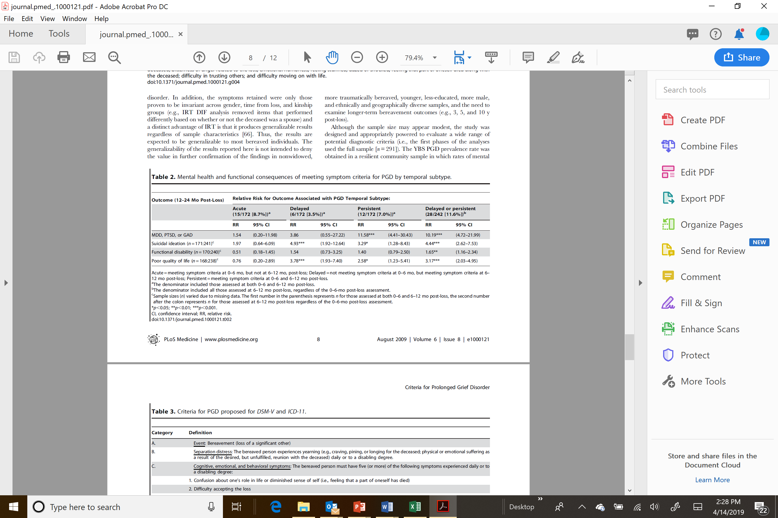
Predictive Validity of Temporal Subtypes to Determine
6-months Criterion for PGD
6-months post-loss Point Prevalence = 11.6%

Slide 14
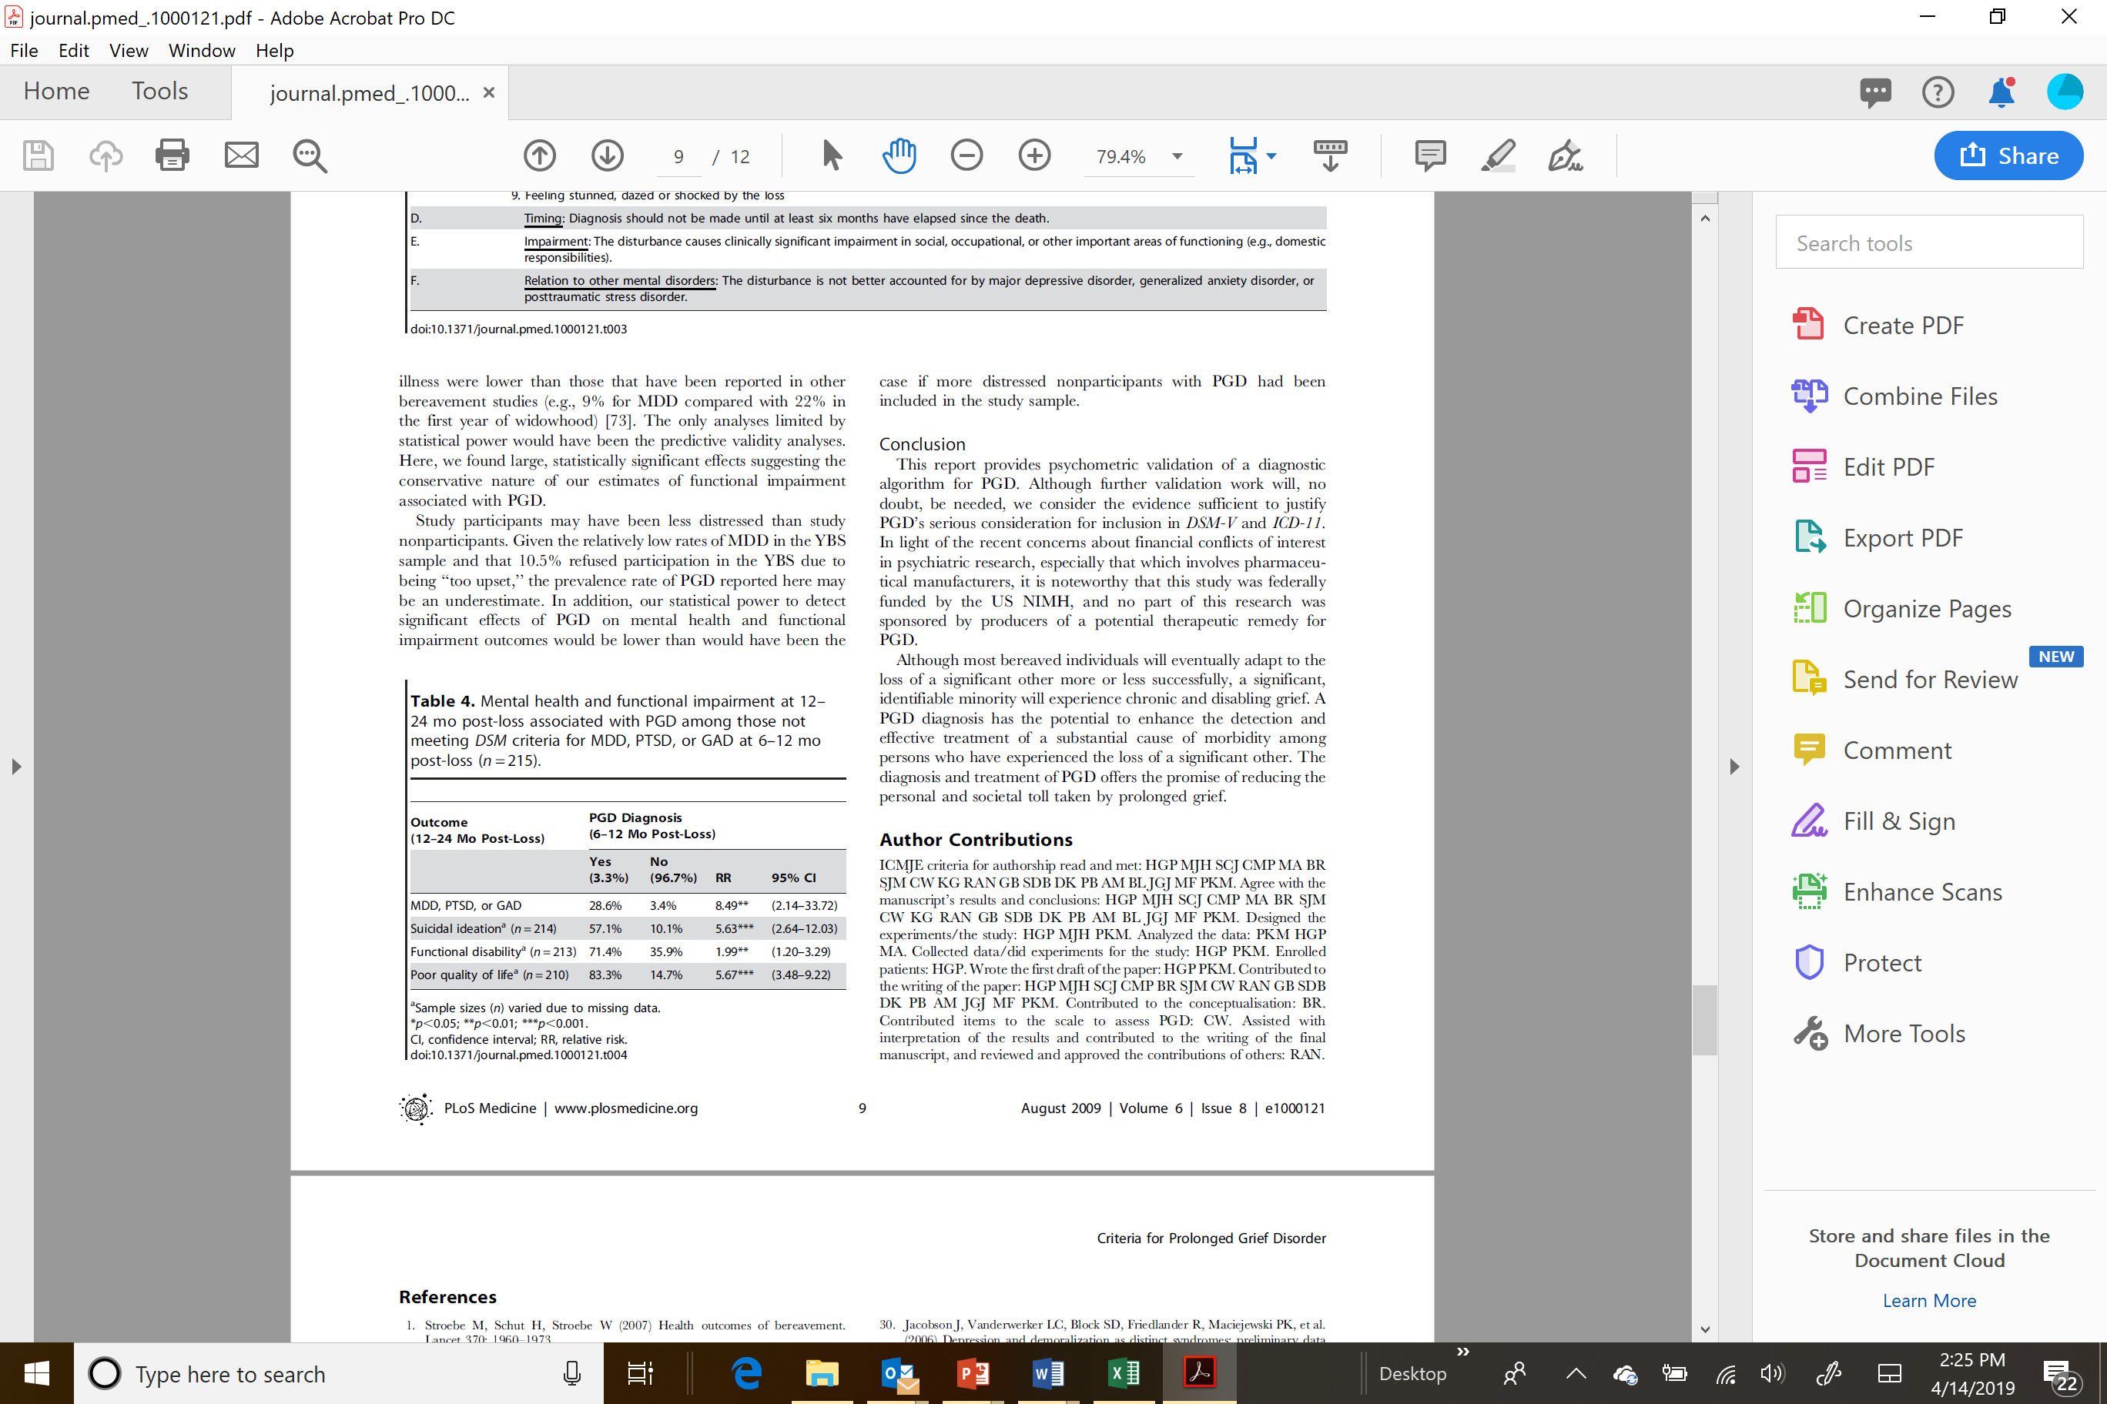
PGD – (Incremental) Predictive Validity
Prigerson et al., PLoS Med 2009

Slide 15
Would those diagnosed with PGD feel …
Stigmatized – would bereaved be labeled as inferior and blamed for their distress?
Rejected, unsupported, misunderstood by their family – would family members w/draw support?
Want help for their emotional distress – would they be receptive to treatments to minimize their distress?
Yale Bereavement Study
Johnson et al. 2009

Slide 16
Stigma & Receptivity to Treatment re: PGD
> 90% subjects think family/friends would be more
understanding if diagnosed w/ PGD
If told they had PGD:
  > 95 % of subjects would be relieved to have a recognizable problem
  > 98% would be interested in treatment for this condition – 100% of those meeting criteria for PGD
Yale Bereavement Study
Johnson et al. 2009

Slide 17
Clinical Utility of a PGD Diagnosis
In the DSM 5, p. 20 it states:
“…a mental disorder should have clinical utility [that is]: it should help clinicians to determine prognosis, treatment plans, and potential treatment outcomes for their patients…
Spitzer in “Diagnosis and need for treatment are not the same.”
Arch Gen Psychiatry. 1998;5:120
cautioned that…
“the diagnosis of a mental disorder is not equivalent to a need for treatment … [and]…
To confuse making a mental disorder diagnosis with demonstrating treatment need [is] a serious mistake.”

Slide 18
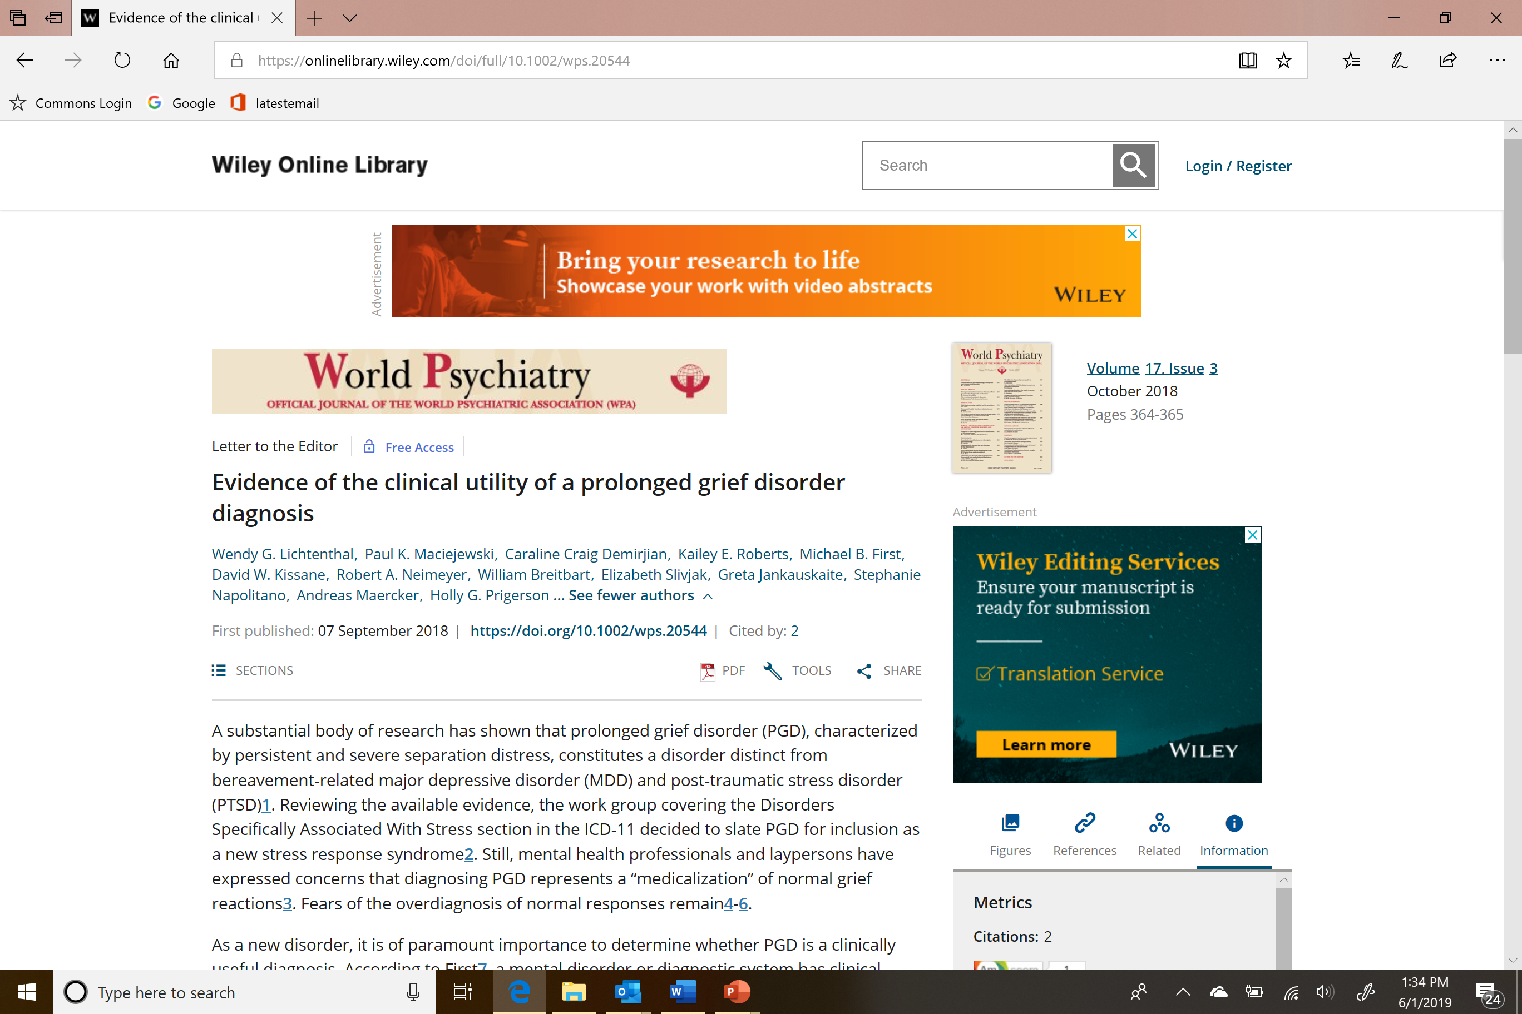
Clinicians Found the PGD Criteria Clinically Useful
“Testing the Clinical Utility of PGD Diagnosis”
(NIMH R21 MPI: Lichtenthal/Prigerson)
the majority of clinicians rating those criteria as easy to use (97%)
overall clinically useful (95%)

Slide 19



Virtual Standardized Patients
“Testing the Clinical Utility of PGD Diagnosis”
(NIMH R21 MPI: Lichtenthal/Prigerson)
PGD
PTSD
Normal Grief

Slide 20
Clinicians can accurately diagnose PGD
Patient Vignette | Diagnosis | Full Sample |  | Tutored |  | Untutored
 |  | n | % | n | % | n | % | OR | Lower | Upper | p
PTSD | Correct | 71 | 88.8% | 42 | 87.5% | 29 | 90.6% | 0.72 | 0.17 | 3.13 | 0.666
 | Incorrect | 9 | 11.3% | 6 | 12.5% | 3 | 9.4%
MDD | Correct | 61 | 76.3% | 36 | 75.0% | 25 | 78.1% | 0.84 | 0.29 | 2.43 | 0.748
 | Incorrect | 19 | 23.8% | 12 | 25.0% | 7 | 21.9%
PGD | Correct | 122 | 76.3% | 83 | 86.5% | 39 | 60.9% | 4.09 | 1.89 | 8.85 | 0.000
 | Incorrect | 38 | 23.8% | 13 | 13.5% | 25 | 39.1%
Normative Grief | Correct | 132 | 82.5% | 78 | 81.3% | 54 | 84.4% | 0.80 | 0.34 | 1.87 | 0.611
 | Incorrect | 28 | 17.5% | 18 | 18.8% | 10 | 15.6%
Clinicians who received a brief tutorial on PGD were 4x more likely to accurately diagnose patients with PGD
Mental health clinicians who received the tutorial were not more likely to pathologize normal grief
Notes:
This trial suggested that in fact training CAN help. We gave a very brief tutorial—just 8 slides, with no human coaching or even audio or video—and found that clinicians who received this training better able to correctly diagnose the individuals who depicted PGD—in fact FOUR TIMES more likely to get it right. And, fortunately, we did not find evidence supporting the big concern I know many of us have—will telling people about PGD make them more likely to pathologize grief? In fact, clinicians who received the PGD tutorial were no more likely to diagnose normative grief as PGD.

Slide 21
Cross-Validation: Item Information
Simon et al. Depression & Anxiety 2011

Slide 22
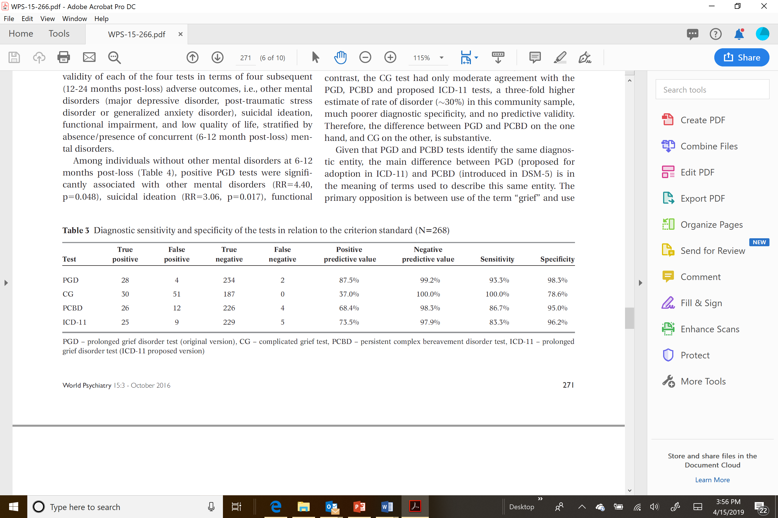
Cross-Validation: Psychometric Performance
Maciejewski et al. World Psychiatry 2016

Slide 23
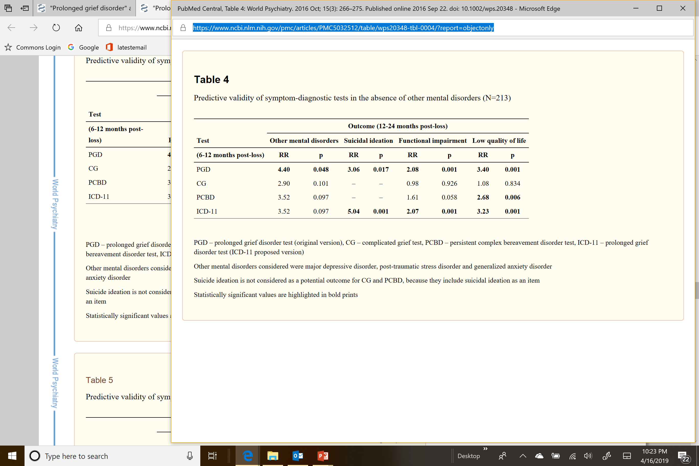
Cross-Validation: Predictive (Incremental) Validity
Maciejewski et al. World Psychiatry 2016

Slide 24
Cross-Validation: Reliable Rate of Diagnosis of PGD in Two Community Samples
Yale Bereavement Study
National Military Family Bereavement Study
Full Sample
Full Sample
CG
PGD
CG
PGD
30%
23%
11%
11%
Maciejewski et al. World Psychiatry 2016
Cozza et al. AJP 2016

Slide 25
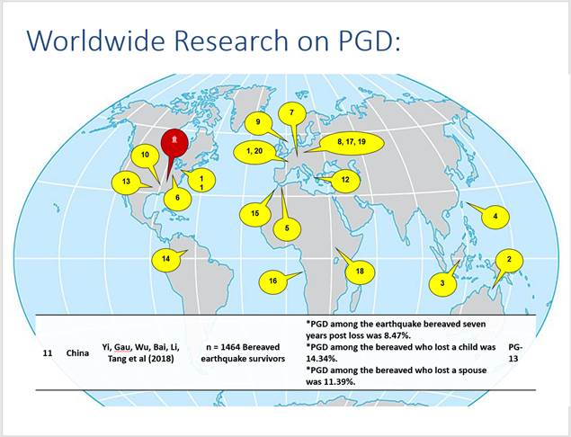
PGD/PG-13
Validated Cross-culturally
(> 24 published studies & counting;
~600 citations)

Slide 26
Prevalence of PGD in Adult Bereavement = 10% [95% CI: (7%, 14%)]

Slide 27
Evidentiary Scorecard as of DSM-5 TR (June 2019)
Prolonged Grief Disorder
(PGD)
Complicated Grief
(CG)
Domain | Item |  | Yes |  |  | No |  |  | Unknown |  |  |  | Yes |  |  | No |  |  | Unknown
Validity | Construct |  |  | √ |  |  |  |  |  |  |  |  |  |  |  |  |  |  |  | √
 | Concurrent |  |  | √ |  |  |  |  |  |  |  |  |  |  |  |  |  |  |  | √
 | Discriminant |  |  | √ |  |  |  |  |  |  |  |  |  |  |  |  |  |  |  | √
 | Predictive |  |  | √ |  |  |  |  |  |  |  |  |  |  |  |  | √
Measurement | Reliability |  |  | √ |  |  |  |  |  |  |  |  |  | √
 | Sensitivity |  |  | √ |  |  |  |  |  |  |  |  |  | √
 | Specificity |  |  | √ |  |  |  |  |  |  |  |  |  |  |  |  | √
 | Accuracy |  |  | √ |  |  |  |  |  |  |  |  |  |  |  |  | √
Acceptability | Stigma |  |  | √ |  |  |  |  |  |  |  |  |  |  |  |  |  |  |  | √
 | Clinical Utility |  |  | √ |  |  |  |  |  |  |  |  |  |  |  |  |  |  |  | √
Robustness | Cross-Validation |  |  | √ |  |  |  |  |  |  |  |  |  |  |  |  |  |  |  | √
 | Cross-Cultural Validity |  |  | √ |  |  |  |  |  |  |  |  |  |  |  |  |  |  |  | √

Slide 28
Now that we’ve reviewed evidence validating our PGD criteria, let’s turn to how we can improve upon ICD-11 PGD criteria …

Slide 29
PGD as Defined in ICD-11
ICD-11 (2018)
Key Elements
Prolonged grief disorder is a disturbance in which, following the death of a partner, parent, child, or other person close to the bereaved, there is persistent and pervasive grief response characterized by longing for the deceased or persistent preoccupation with the deceased accompanied by intense emotional pain (e.g. sadness, guilt, anger, denial, blame, difficulty accepting the death, feeling one has lost a part of one’s self, an inability to experience positive mood, emotional numbness, difficulty in engaging with social or other activities). The grief response has persisted for an atypically long period of time following the loss (more than 6 months at a minimum) and clearly exceeds expected social, cultural or religious norms for the individual’s culture and context. Grief reactions that have persisted for longer periods that are within a normative period of grieving given the person’s cultural and religious context are viewed as normal bereavement responses and are not assigned a diagnosis. The disturbance causes significant impairment in personal, family, social, educational, occupational or other important areas of functioning.
Context
Death of a person close to the bereaved
Gateway Symptom
Persistent longing for or preoccupation with the deceased
Other Symptoms
Sadness, guilt, anger, denial, blame, difficulty accepting the death, feeling one has lost a part of one’s self, an inability to experience positive mood, emotional numbness, difficulty in engaging with social or other activities
Time from Loss Criterion
Grief response has persisted for an atypically long period of time following the loss (more than 6 months at a minimum)
Qualifications
Grief response falls outside social, cultural or religious norms and causes impairment

Slide 30
Recommendation #1
Recommendation
Call the disorder prolonged grief disorder (PGD)
Reasons
Most evidence validates the syndrome identified in PLoS Medicine named PGD
A new name would imply a new set of untested symptoms
ICD-11 calls it PGD, a new name would create added confusion about harmonizing with ICD-11
The scientific community has and will continue publishing on PGD
The concept of unresolving intense grief, is neither “complicated” nor “complex”

Slide 31
Recommendation #2
Recommendation
Move the disorder to Section II in DSM-5-TR
Reasons
Evidence supports PGD as a mental disorder
ICD-11 recognizes PGD

Slide 32
Recommendation #3
Recommendation
Require yearning (i.e., longing, pining, pangs of grief) as the sole, mandatory, “gateway” symptom
Reasons
Yearning is the defining characteristic of grief
Yearning is a common, hence sensitive, symptom
Simplifies diagnostic criteria
Neurobiological correlates of yearning in bereavement

Slide 33
Yearning Key Gateway Symptom for PGD
PGD in ICD-11 -- Criterion B
“Gateway Symptom: Persistent longing for, or preoccupation with, the deceased”
Yearning is a defining, essential characteristic of grief as attachment disturbance (~ sadness for depression; ~fear for anxiety)
Yearning is unique to PGD; not symptom of other disorders
Intense yearning is a common (~60%), thus, highly sensitive, grief indicator
Preoccupation with deceased is relatively rare (~10%) in bereavement; nearly all individuals who experience preoccupation also experience yearning, so little gained by adding preoccupation

Slide 34
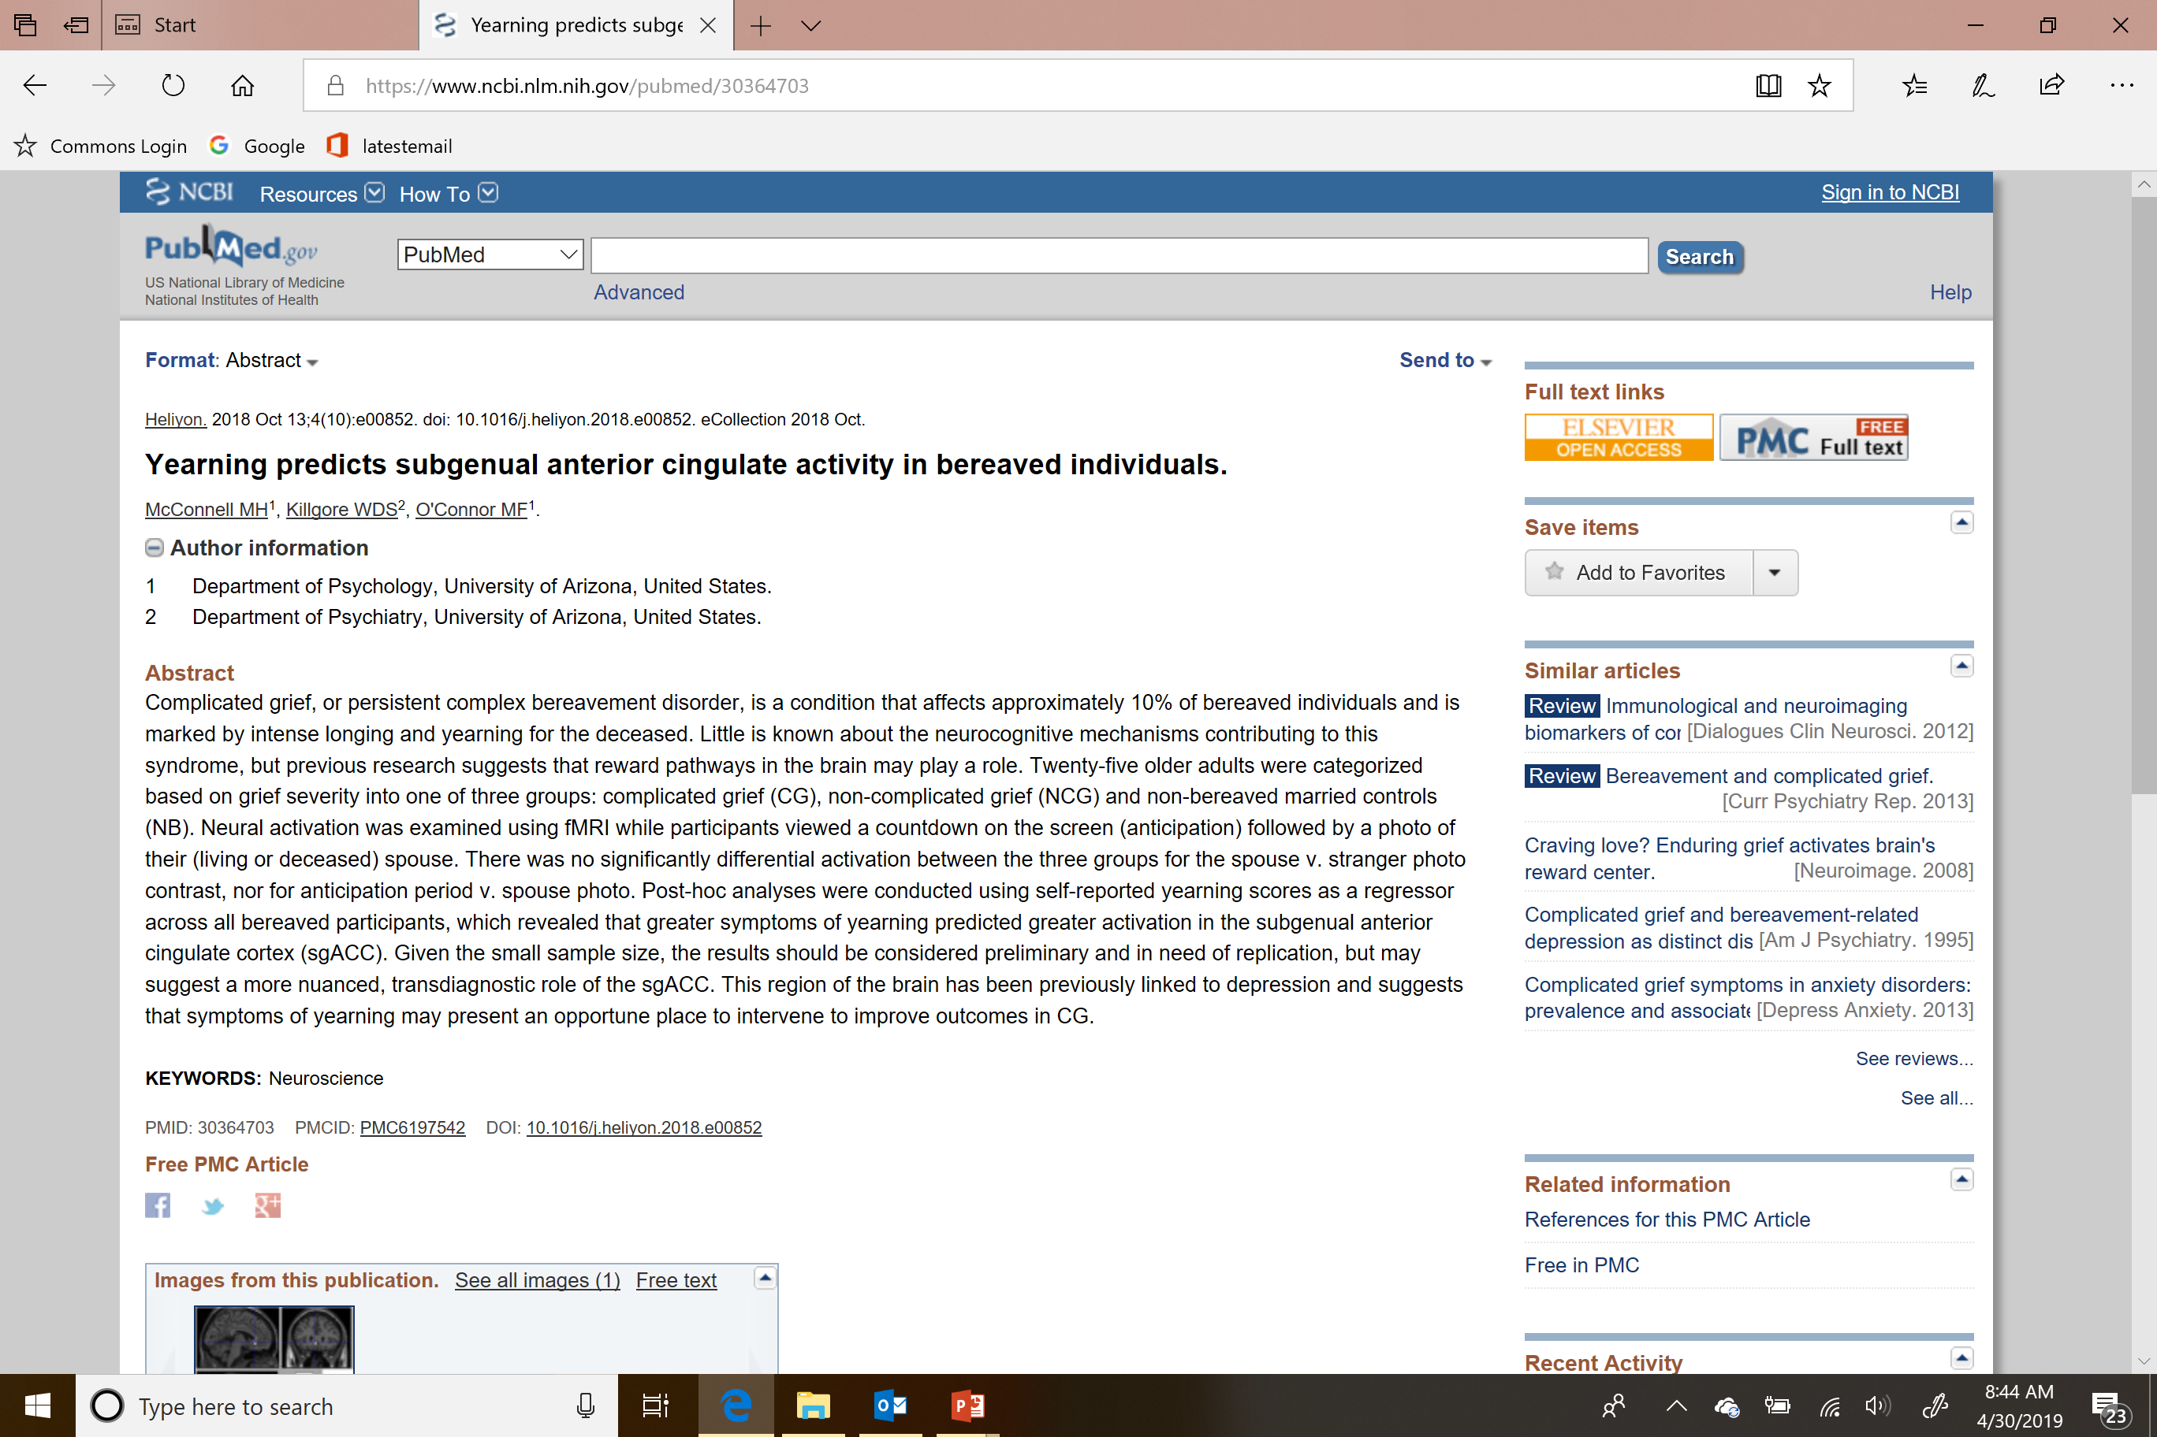
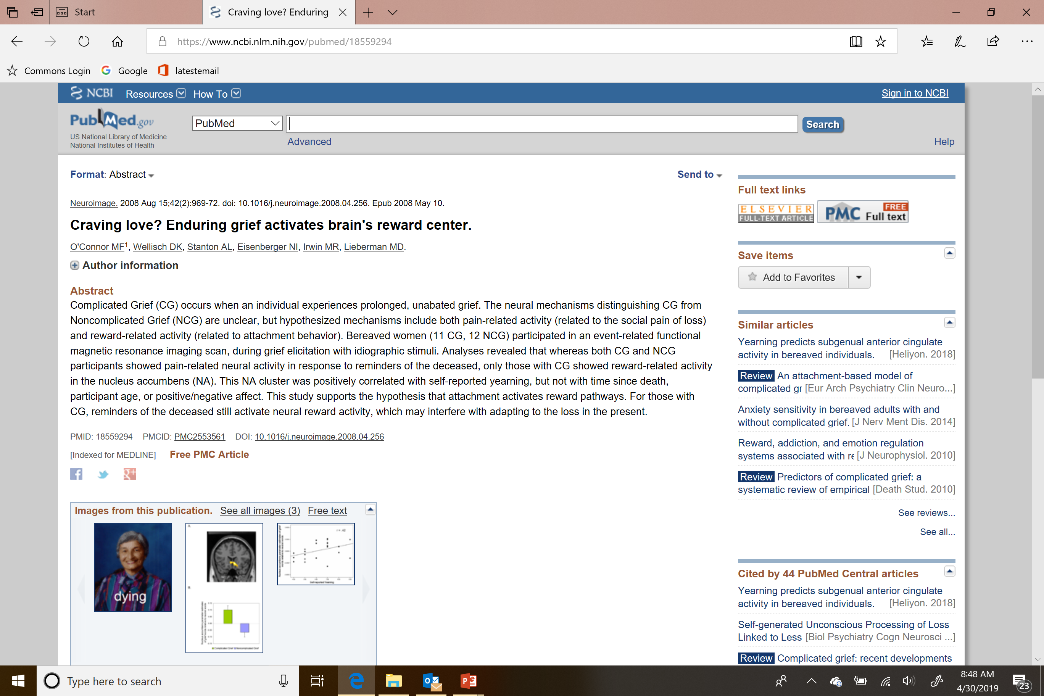
Neurobiological Correlates of Yearning

Slide 35
Recommendation #4
Recommendation
Prioritize diagnostic specificity
Reasons
Avoid pathologizing normal grief
Avoid inflating prevalence rate of diagnosis
Minimize misdiagnosis and mistreatment

Slide 36
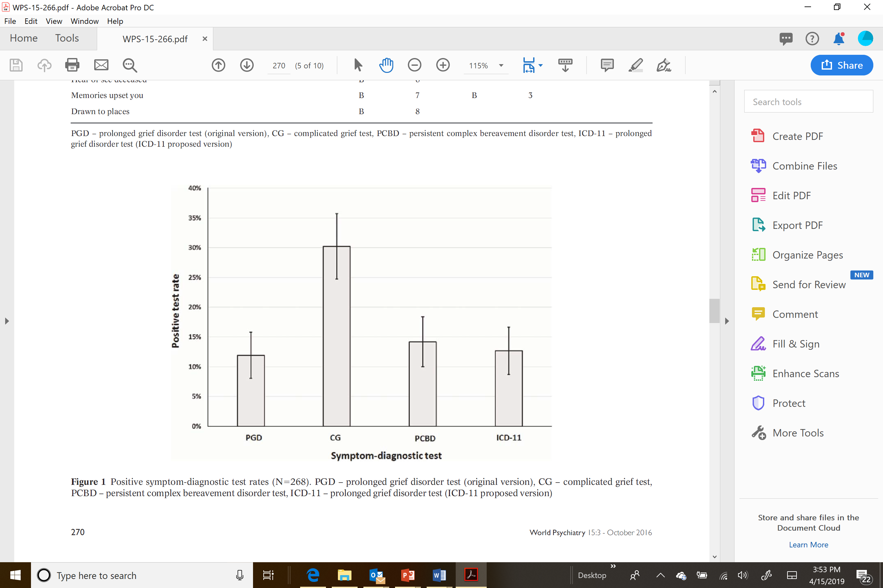
Prevalence Rates by Diagnosis
Maciejewski et al. World Psychiatry 2016

Slide 37
Recommendation #5
Recommendation
Permit diagnosis after 6 months post-loss
Reasons
Evidence supports robust recognition of PGD after 6 months
Symptoms in normal grief generally subside within 6 months
Early diagnosis permits early treatment

Slide 38
Predictive Validity of Temporal Subtypes to Determine
6-months Criterion for PGD
6-months post-loss Point Prevalence = 11.6%

Slide 39
Time from Loss: Course of Normal Grief
Maciejewski et al. (JAMA 2007)

Slide 40
Recommendation #6
Recommendation
Include only tested, grief-specific, “accessory” symptoms
Reasons
Minimize overlap with other disorders
Establish PGD as a grief-specific disorder
Facilitates clinical and general understanding of the disorder

Slide 41
PGD in ICD-11 – Criterion C – the Missteps
“Intense Emotional Pain: This may be manifest as:
sadness, guilt, anger, denial, blame, difficulty accepting the death, feeling one has lost a part of one’s self, an inability to experience positive mood, emotional numbness, difficulty in engaging with social or other activities”
ICD-11 doesn’t specify how many symptoms needed
Grief symptoms --OK: Anger, difficulty accepting the death, feeling one has lost a part of one’s self, emotional numbness, and difficulty in engaging with social or other activities --validated
Depressive symptoms -- not OK: Sadness, guilt, blame, an inability to experience positive mood
Specious Symptom: Denial – unvalidated, how assess?

Slide 42
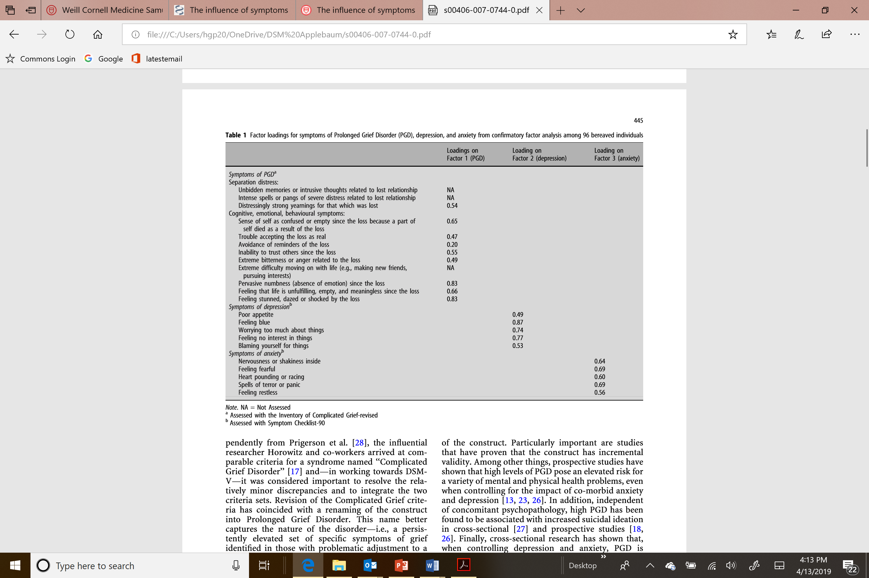
Problematic Symptoms for Diagnosing PGD
Boelen, Prigerson (Eur Arch Psychiatry Clin Neurosci 2007)

Slide 43
Cluster Analysis: grief, depression, anxiety symptoms
VOICE NCI R01 (MPI: Duberstein/Prigerson) 2014-2019

Slide 44
Incremental Predictive Validity of a Simple, Grief-Specific, Symptom-Diagnostic Test
Gateway “B” symptom: Yearning
Accessory “C” symptoms: Stunned by the loss, confused about role in life, trouble accepting the loss, bitterness over the loss, difficulty moving on, emotional numbness, life empty since loss
Predictive validity of tests in the absence of other mental disorders (N=213)
Notes:
This is the criteria set we would recommend for DSM-5-TR

Slide 45
Proposed Modifications to DSM-5 and ICD-11
PGD PCBD (DSM-5, 2013)
PGD (ICD-11, 2018)
Gateway Symptom
Persistent yearning/longing for the deceased, intense sorrow and emotional pain in response to the death, preoccupation with the deceased, or preoccupation with the circumstances of the death
Other Symptoms (6 of 12 5 of 7 required)
Stunned by the loss, difficulty accepting the death, disbelief or emotional numbness over the loss, difficulty with positive reminiscing about the deceased, bitterness or anger related to the loss, maladaptive appraisals about oneself in relation to the deceased or the death (e.g., self-blame), excessive avoidance of reminders of the loss, desire to die in order to be with the deceased, difficulty trusting other individuals since the death, feeling alone or detached from other individuals since the death, feeling that life is meaningless or empty without the deceased (or the belief that one cannot function without the deceased), confusion about one’s role in life, or a diminished sense of one’s identity (e.g., feeling that a part of oneself died with the deceased), or difficulty or reluctance to pursue interests since the loss or to plan for the future in engaging with social or other activities
Time from Loss Criterion
Diagnosed only if at least 12 6 months have elapsed since the death
Gateway Symptom
Persistent yearning/longing for or preoccupation with the deceased
Other Symptoms (number required not specified)
Sadness, guilt, anger, denial, blame, Stunned by the loss, difficulty accepting the death, feeling that life is meaningless or empty without the deceased, feeling one has lost a part of one’s self, an inability to experience positive mood, bitterness or anger related to the loss, emotional numbness, or difficulty in engaging with social or other activities
Time from Loss Criterion
Grief response has persisted for an atypically long period of time following the loss (more than 6 months at a minimum)

Slide 46
Summary of Recommendations to DSM-5.1-TR
Recommendations:
Call the disorder prolonged grief disorder (PGD)
Move the disorder to Section II in DSM-5-TR
Require yearning (i.e., longing, pining, pangs of grief) as the sole, mandatory, “gateway” symptom
Prioritize diagnostic specificity
Permit diagnosis after 6 months post-loss
Include only tested, grief-specific, “accessory” symptoms (remove symptoms of depression, anxiety, PTSD)
Thank you for the opportunity to present and synthesize decades of work on diagnosing PGD

Slide 47
Extra slides

Slide 48
Predictive Validity of a Simple, Grief-Specific, Symptom-Diagnostic Test
Gateway “B” symptom: Yearning
Accessory “C” symptoms: Stunned by the loss, confused about role in life, trouble accepting the loss, bitter over the loss, difficulty moving on, emotionally numbness, life empty since loss
Predictive validity of symptom-diagnostic tests in the absence of other mental disorders (N=213)
Predictive validity of symptom-diagnostic tests in the presence of other mental disorders (N=27)

Slide 49
PGD vs. MDD
Attachment disturbance -- triggered by loss, craving for lost object | Not Attachment disturbance – not loss specific, craving for lost object
Factor/Cluster analyses reveal different symptoms: Yes: yearning disbelief, emotional numbness, identity confusion, feeling a part of you has died, bitter about loss No: sad, low mood, blame, loss of interest, loss of energy, appetite, sleep disturbance Discriminant Validity – phi ~.3-.5 Different resolution over time – grief persists longer, unabated Different treatment response (tcas, IPT, CGT, HEAL) Different neurobiology (nucleus accumbens activation) Clinically distinguishable (clinicians can reliably make differential diagnosis) | Factor/Cluster analyses reveal different symptoms: No: yearning not disbelief, emotional numbness, identity confusion, feeling a part of you has died, bitter about loss Yes: sad, low mood, blame, loss of interest, loss of energy, appetite, sleep disturbance Discriminant Validity – phi ~.3-.5 Different resolution over time – depressed mood more episodic less chronic Different treatment response (tcas, IPT, CGT, HEAL) Different neurobiologically (no nucleus accumbens activation) Clinically distinguishable (differential diagnosis)

Slide 50
Making the Distinction:
How is PGD Different from Normal Grief?
It is not normal for a bereaved person to feel unsure of who s/he is or where s/he fits in after the loss
It is not normal to be chronically disengaged from others and the world around him/her
It is not normal to feel emotionally numb and disconnected
It is not normal to feel empty without the deceased
It is not normal to feel unsafe and insecure without the deceased

Slide 51
Making the Distinction:
Why is PGD not Major Depressive Disorder?
PGD uniquely includes “separation distress” (yearning and pining for the deceased), which is not seen in other mental disorders
MDD is characterized more by sadness than PGD
PGD symptoms are more stable over time than MDD symptoms

Slide 52
Making the Distinction:
Why is PGD not PTSD?
Yearning is only found in PGD and not present in PTSD
In PGD, memories of the deceased are bittersweet – at once comforting but distressing because they remind the bereaved of the loss
In PTSD, the world is a scary place with danger at every turn and fear is more prominent than PGD’s sorrow over being without a primary source of security and safety

Slide 53
Making the Distinction:
Why is PGD not PTSD?
In PGD, the precipitating event of “loss” is a universal experience
PGD symptoms are related to
  Attachment to the deceased
  Difficulty processing the reality of the loss and reorienting in the world without the deceased
In PGD, there is always an impact on social support network
Fear and threat are less prominent in PGD; sadness is less prominent in PTSD
Adapted from Lichtenthal 2014

Slide 54
Simon et al.’s (2011) Cases vs. non-Cases of CG – Diagnostic Confounds
Cases significantly more GAD, MDD, and PTSD; less Bipolar D, SAD
Criteria for “cases” vs. “non-cases” used to inform proposed diagnostic criteria for Complicated Grief (CG; Shear et al. 2011)
Hence, CG criteria tailored to pick out GAD, MDD, and PTSD as opposed to Bipolar D and SAD

Slide 55
Concerns in Defining “Cases” in Two Recent Studies
Mauro et al. (2019)
Cozza et al. (2019)
“Cases” were participants in a treatment study, had an ICG ≥ 30, and were judged by clinician to have CG as the condition most in need of treatment.
“Cases” defined as a combination of intense grief (ICG ≥ 30) and at least moderate functional impairment (WSAS ≥ 20).
Military deaths 0.05% of US deaths
“Cases” determined largely by functional impairment
“Cases” non-specific to grief
Treatment-seeking sample
Comorbid “cases”
Reliant on Clinical Opinion
73% of “cases” had MDD
41% of “cases” had PTSD
42% w/ intense grief are “cases”
83% w/ functional impairment are “cases”

Slide 56
Rates of Diagnosis by Competing Algorithms in Two Studies:
Yale Bereavement Study (YBS) and National Military Family Bereavement Study (NMFBS)
20%
95% CI
Lundorff et al. (2018)
10%
YBS
NMFBS
YBS
NMFBS
YBS
NMFBS
YBS
NMFBS
Prolonged Grief
Disorder (PGD)
Complicated
Grief (CG)
DSM-5
(PCBD)
ICD-11
(PGD)

Slide 57
Properties of Diagnostic Algorithms in Two Studies Using Two Different Standards
Yale Bereavement Study
Prigerson et al. (2009) Standard
National Military Family Bereavement Study
Cozza et al. (2019) standard
Sensitivity
Specificity
Accuracy
Sensitivity
Specificity
Accuracy
Prolonged Grief
Disorder (PGD)
Complicated Grief
DSM-5 (PCBD)
ICD-11 (PGD)

Slide 58
First, some history…
Timeline of Events Leading Up to Inclusion of Prolonged Grief Disorder in ICD-11
Consensus Report
(BJP 1999)
Prolonged Grief Disorder Proposal
(PGD; PLoS Medicine 2009)
Complicated Grief Proposal
(CG; DA 2011)
NIH R01 Funding of
Yale Bereavement Study (YBS; 1999)
DSM-5 Workgroup Meeting
To Consider PGD (2010)
Publication of DSM-5
(PCBD; APA 2013)
Release of ICD-11
(PGD; WHO 2018)

Slide 59
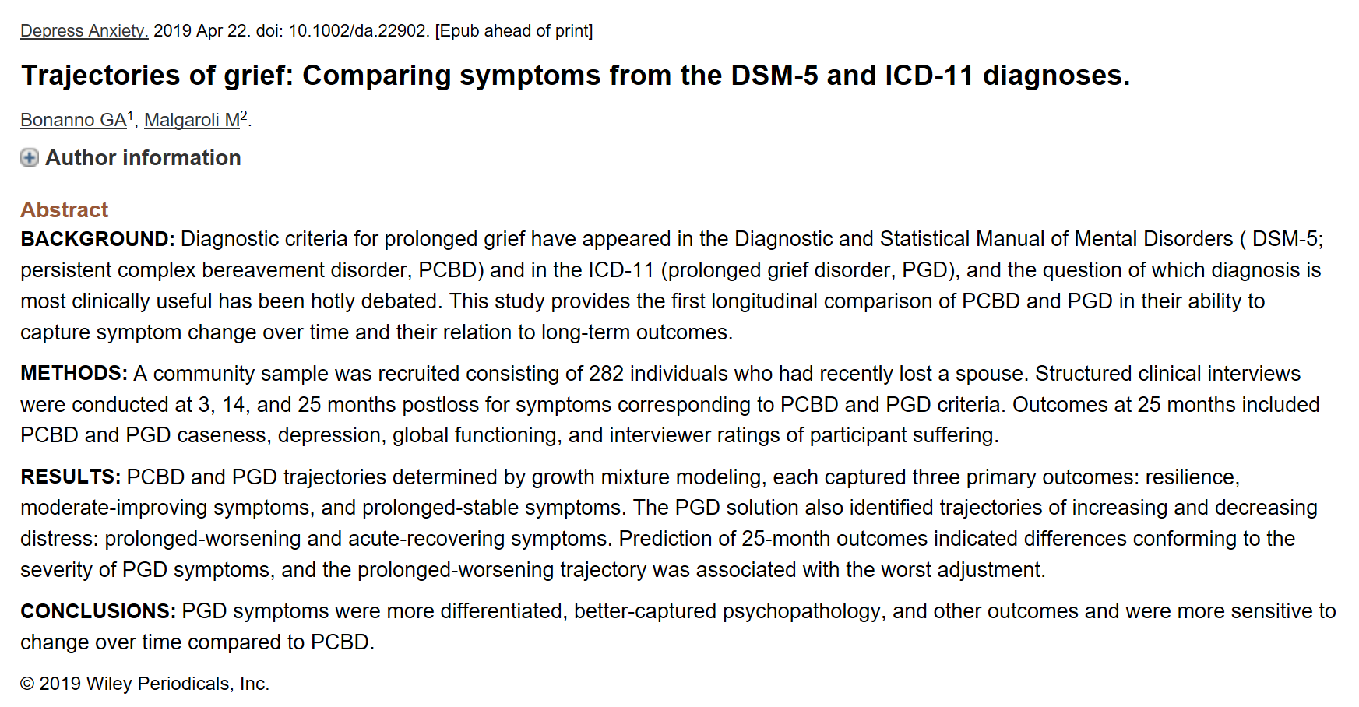

Slide 60
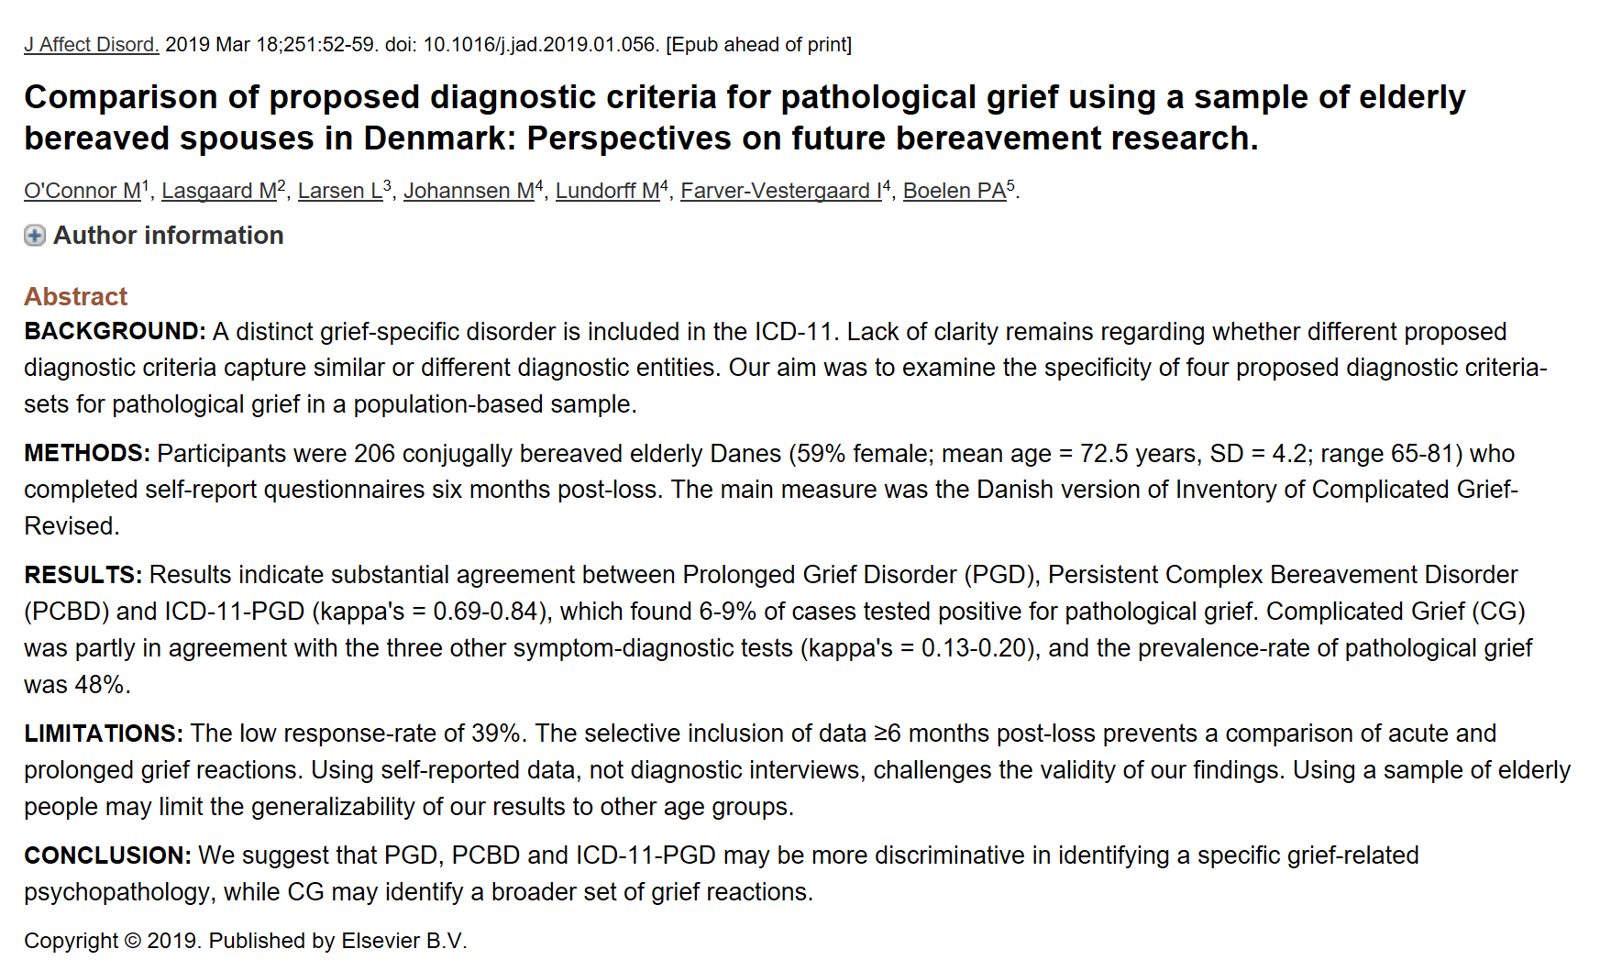
Superiority of PGD Replicated in Danish Sample
Thus, CG is not valid, and PCBD, a compromise between PGD and CG, is also not the superior diagnosis
PGD criteria are superior to the others and validated with longitudinal data and cross-culturally

Slide 61
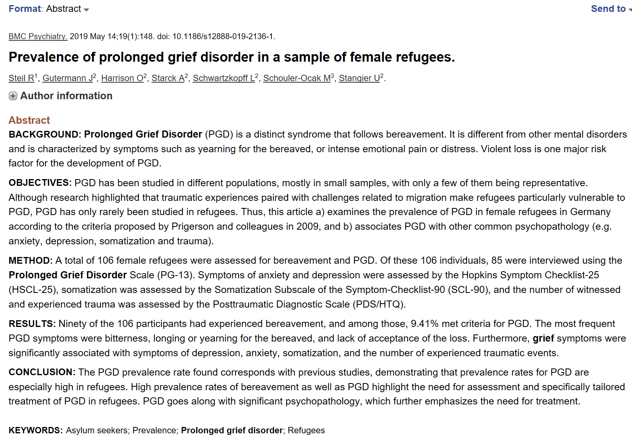
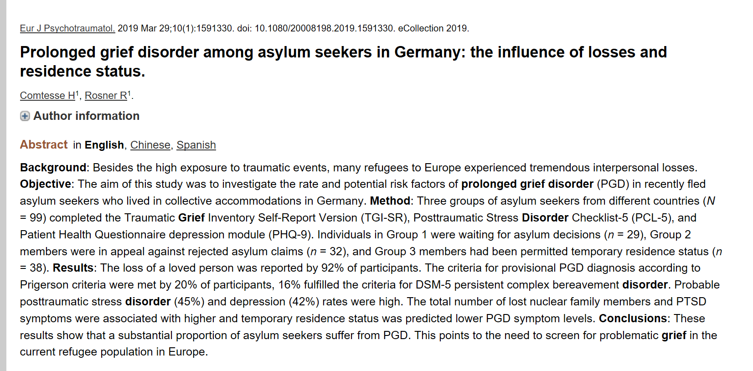
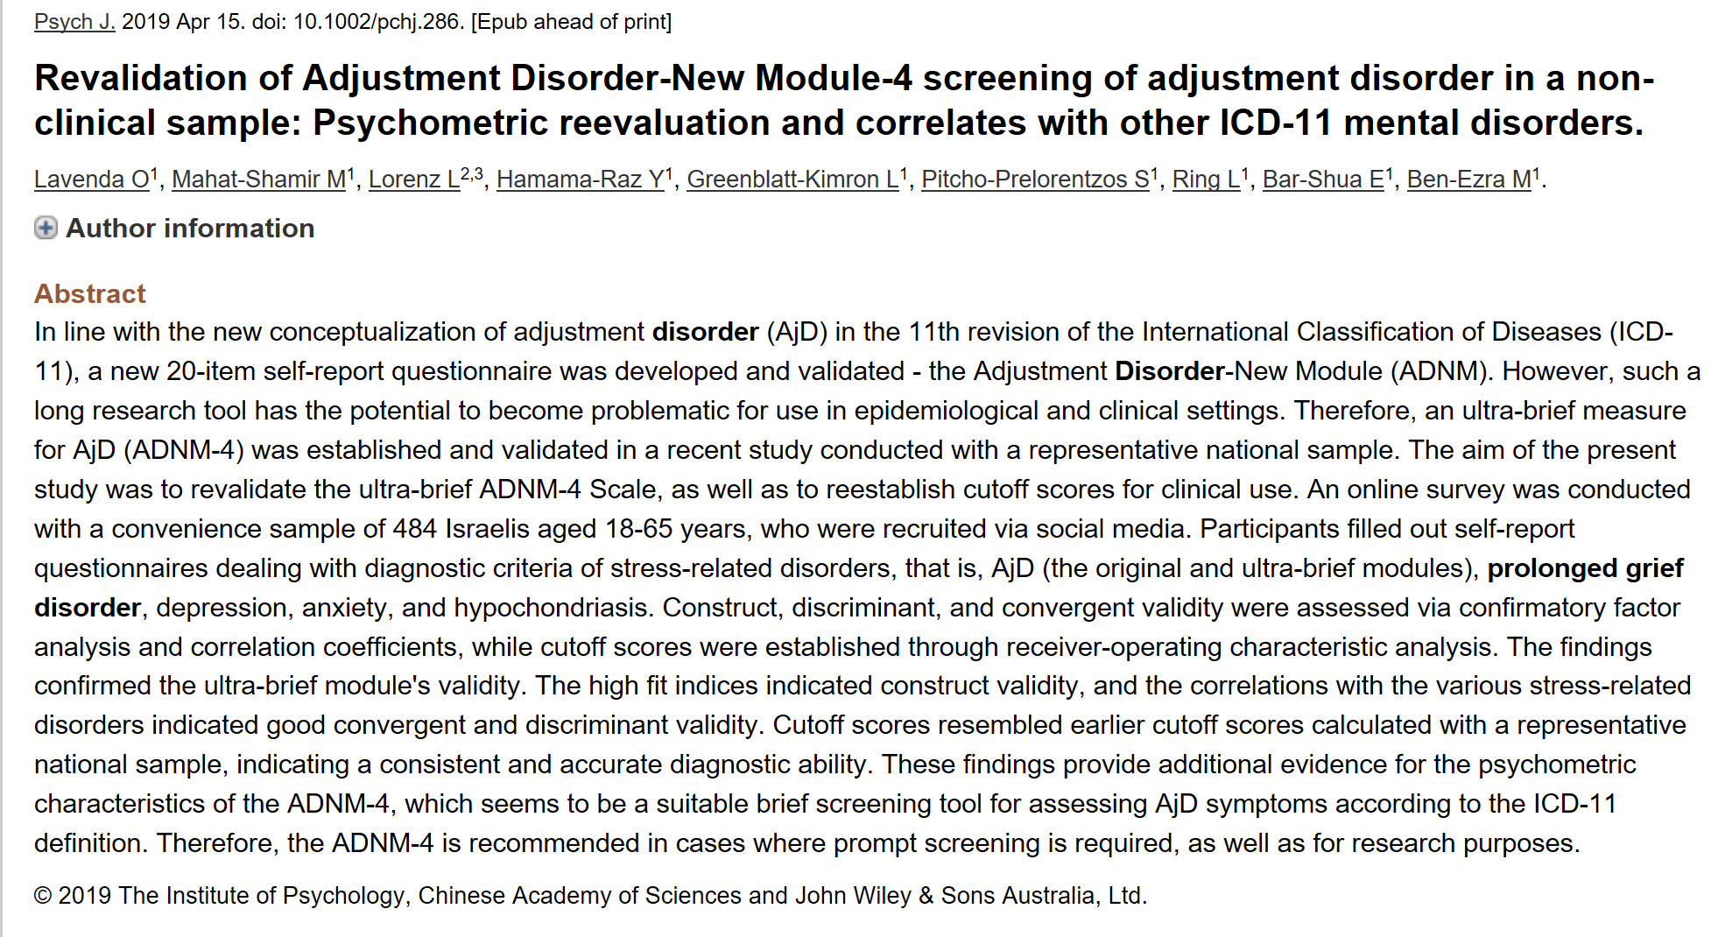

Slide 62
